Slide 1
Introduction to Computing for Data Analysis
Logistic regression (classification)
Richard Vuduc, Ph.D.
Associate Professor
School of Computational Science and Engineering
Maximum likelihood estimation
Notes:
Hi kiddos, I see you made it back. Welcome.
This lesson is about a technique for fitting models called maximum likelihood estimation.
Let’s see how it applies to the analysis task of classification.

Slide 2
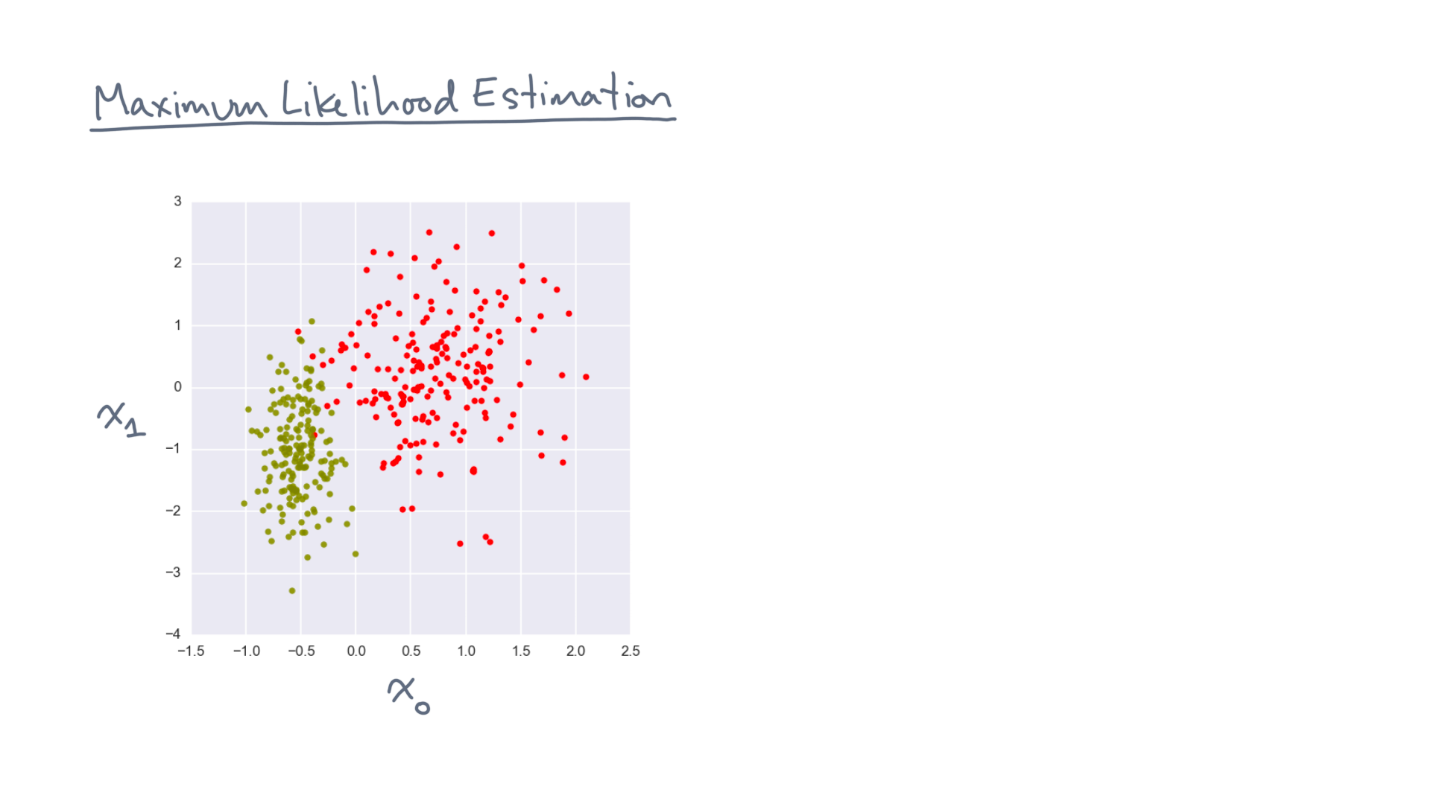
Notes:
Recall that you start with a set of labeled points whose coordinates lie in some continuous space.
Let’s say you’ve decided to build a model of this data in the following way.

Slide 3
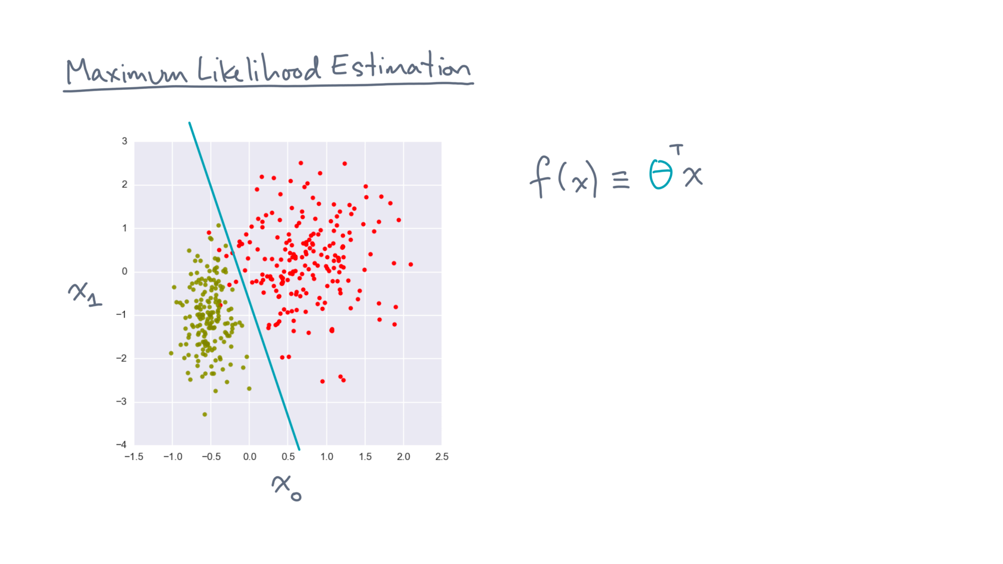
Notes:
First, you’ve decided to look for a linear discriminant.
As such, you can assign a score, f(x), to any point x, where the score is theta-transpose-x.
Theta is an unknown vector of parameters, which we would like to estimate from the data.

Slide 4
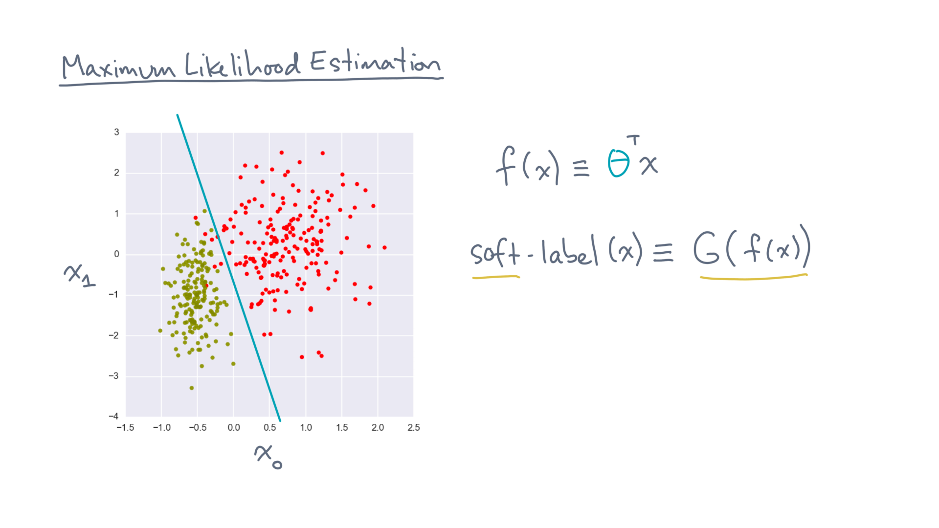
Notes:
Given the score, you decided to convert it into a soft label by applying the logistic or sigmoid function to the score.
“Soft” means that the label will be a continuous, rather than discrete, value.

Slide 5
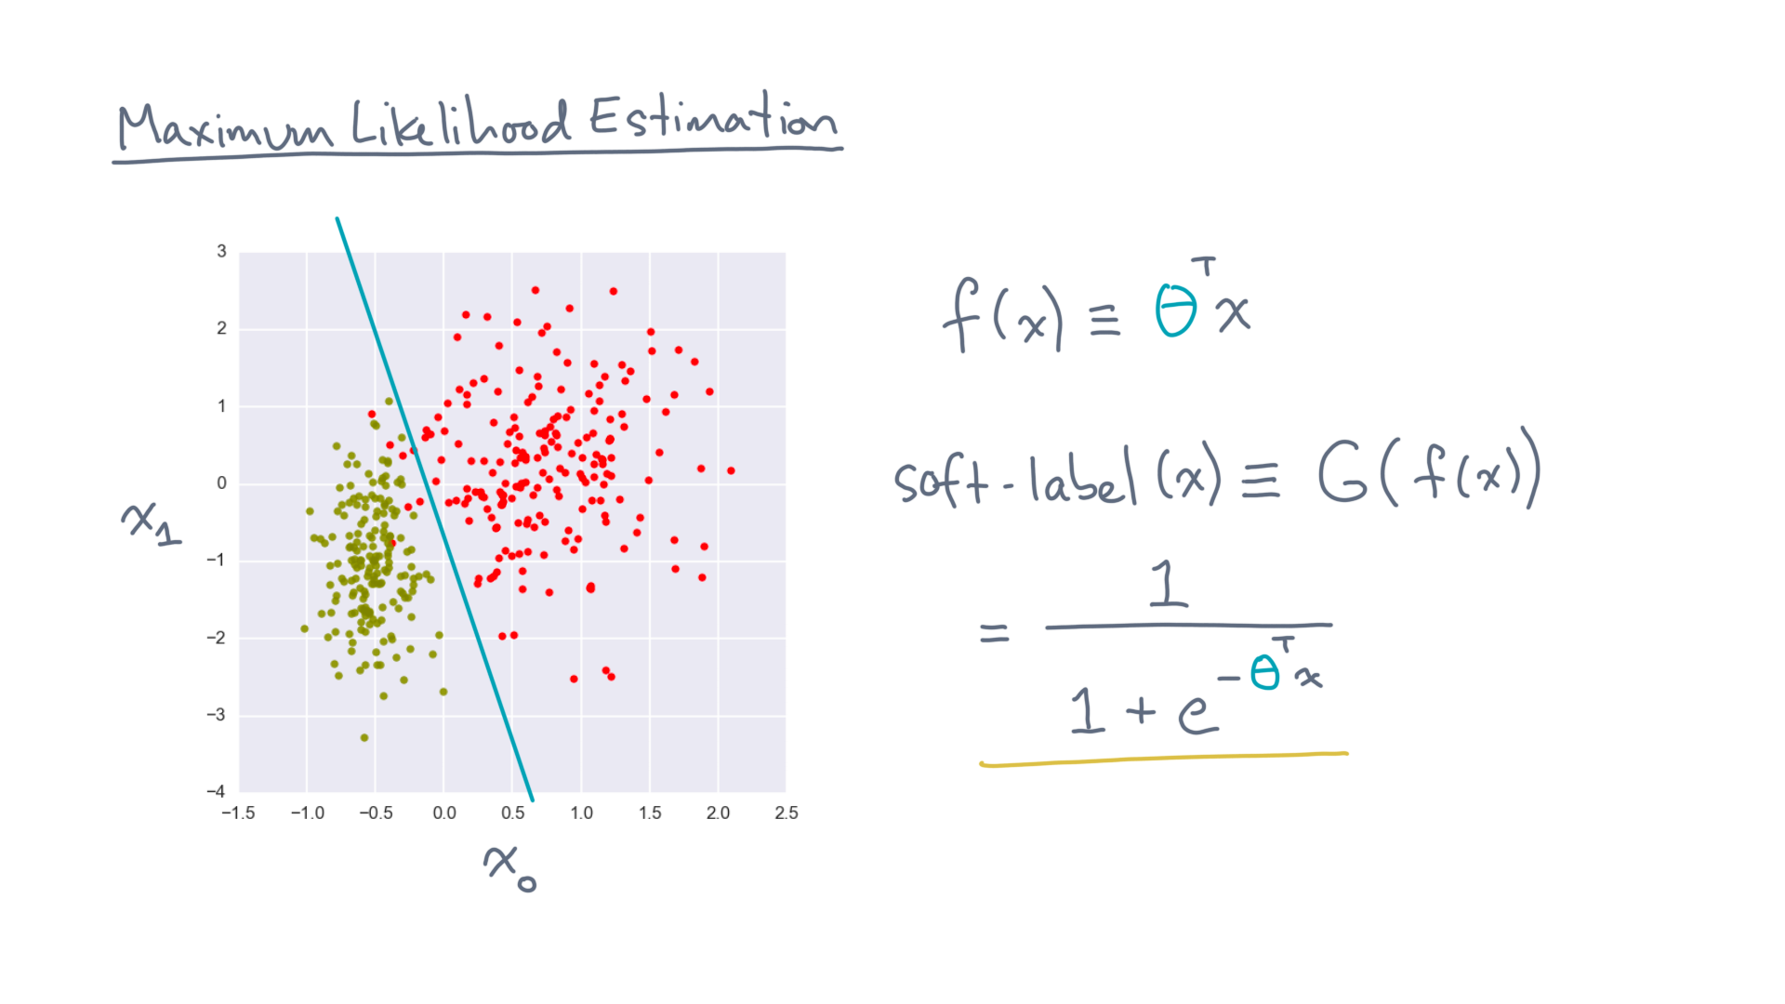
Notes:
In this case, the soft-label at x becomes 1 over 1 + e to the minus theta-transpose-x.
Its values lie between 0 and 1, so we could, for example, round it if you needed to predict a “hard” 0 or 1 label.

Slide 6
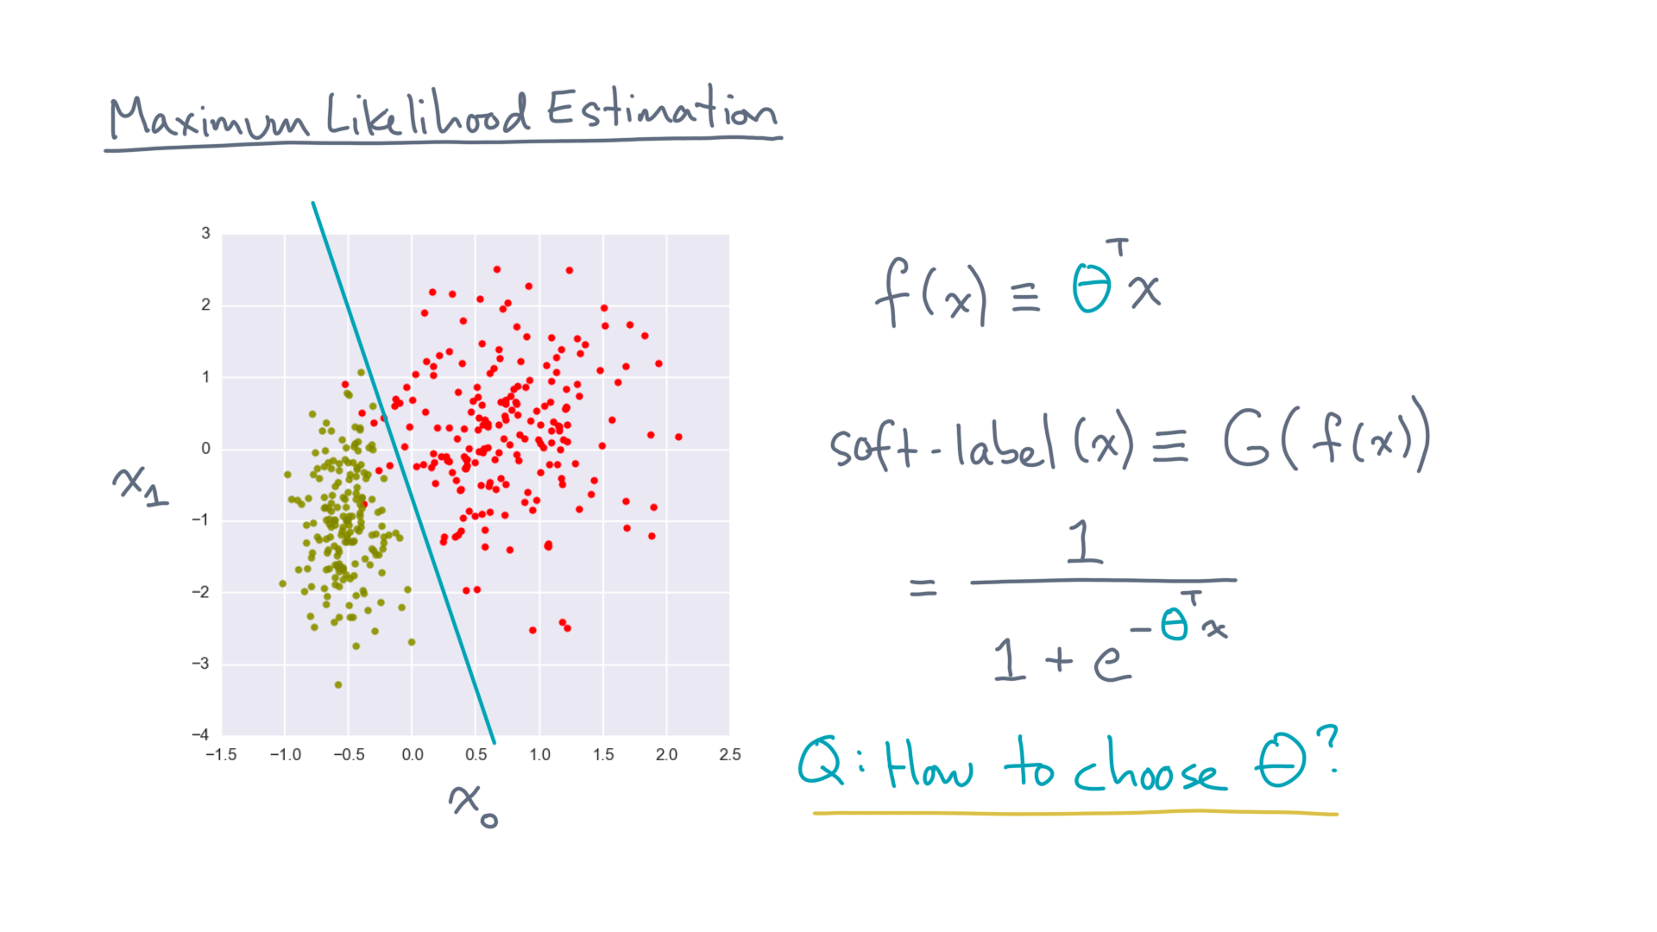
Notes:
The next big question is, how do you choose theta?

Slide 7
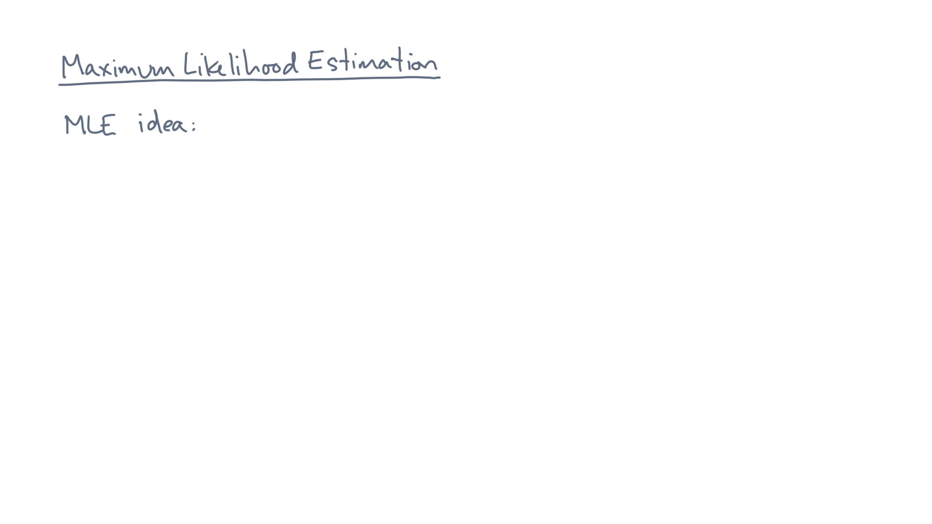
Notes:
Maximum likelihood estimation is one technique.
Let’s walk through the main idea.

Slide 8
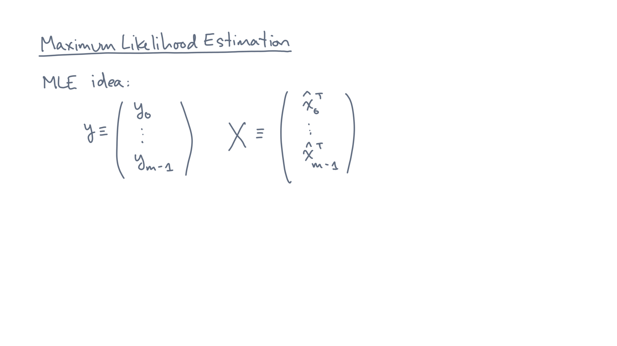
Notes:
Start with the labeled data set, where y is a vector of m-1 responses and X is the corresponding “data matrix” of coordinates.

Slide 9
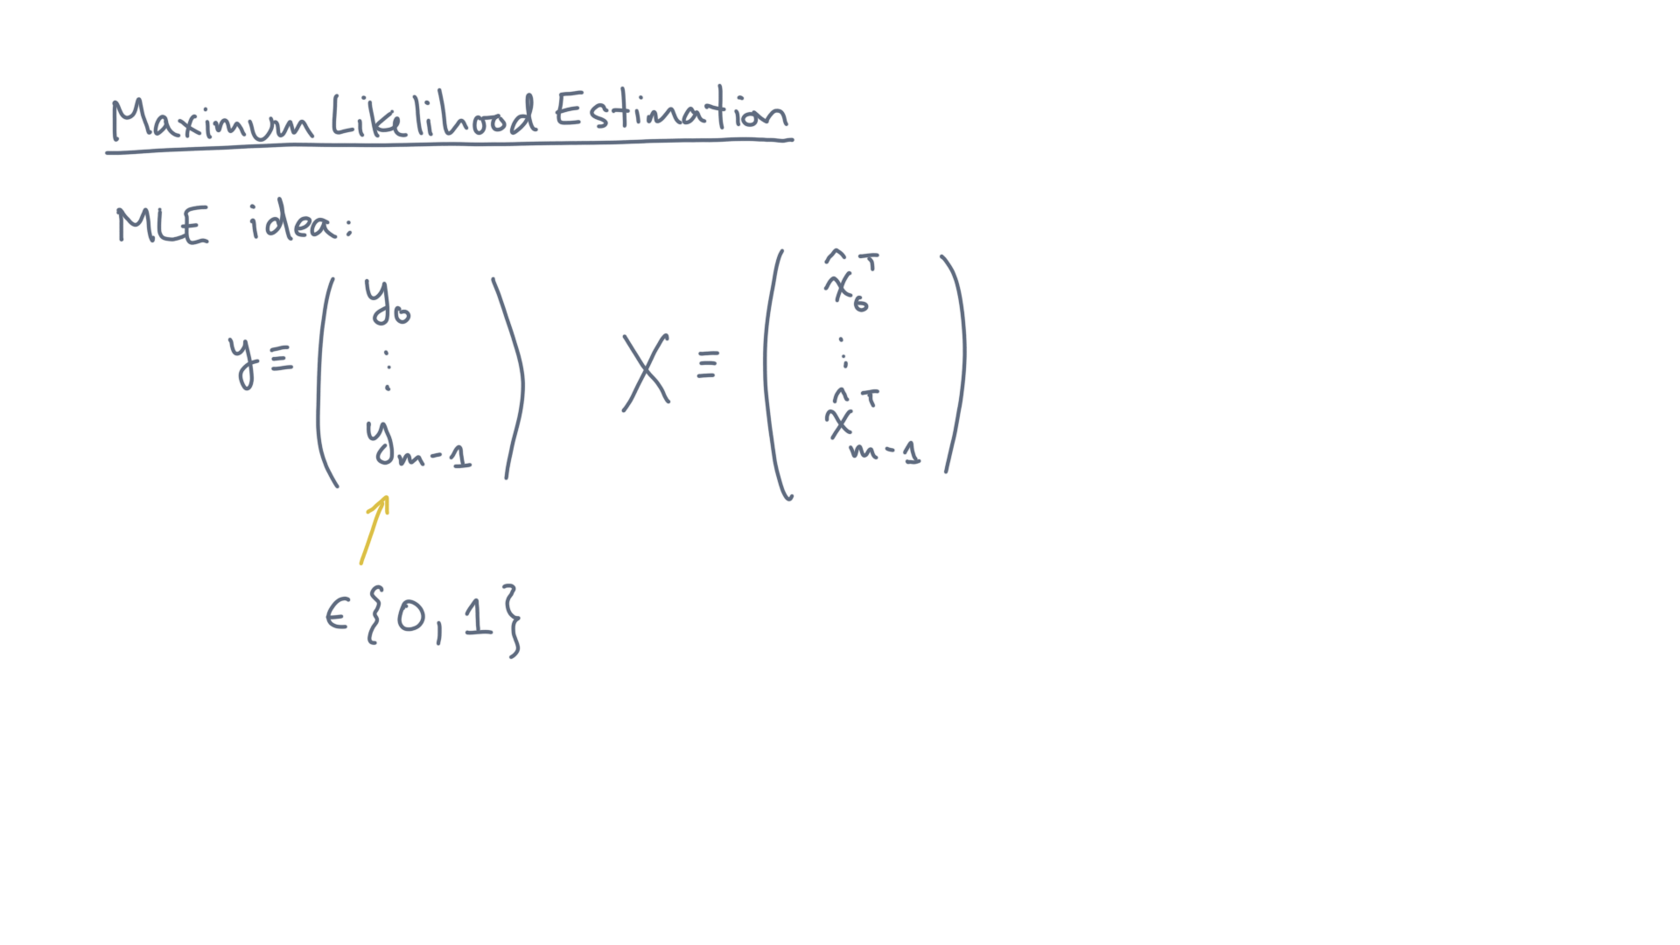
Notes:
The responses are the observed class labels.
Let’s take the values to be binary, either 0 or 1.

Slide 10
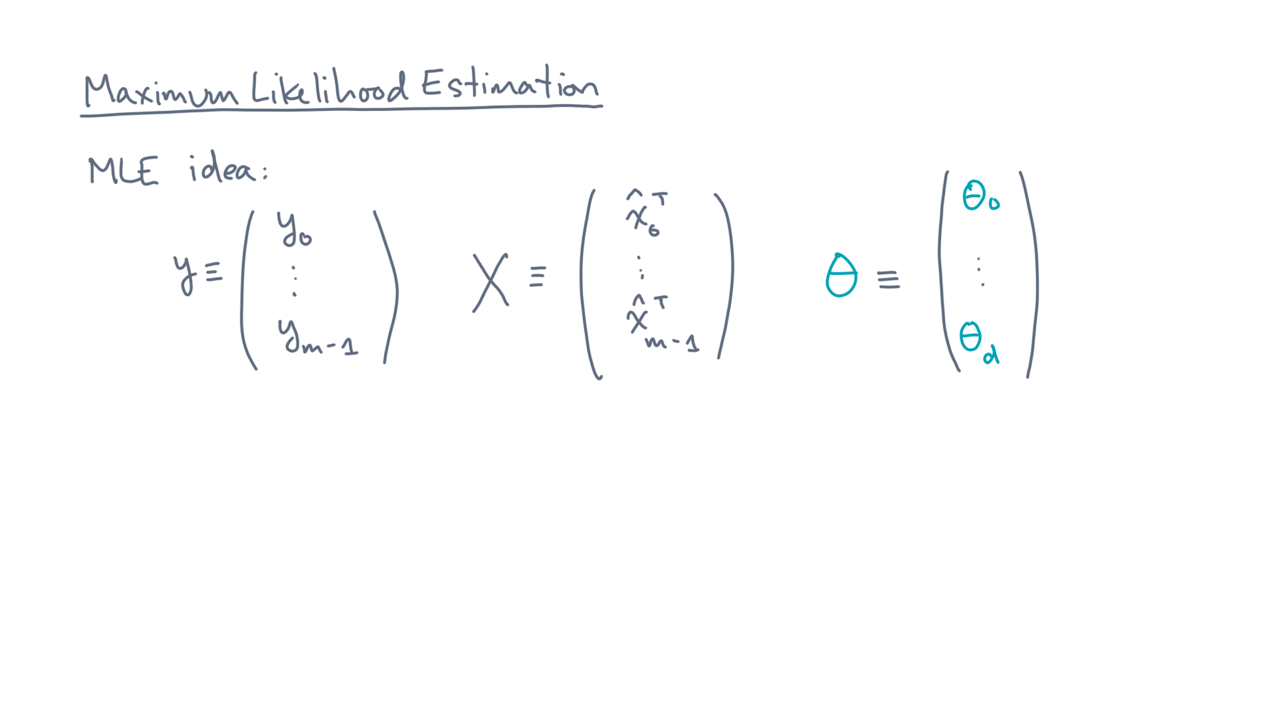
Notes:
Let theta be the vector of parameters that represent the linear discriminant.

Slide 11
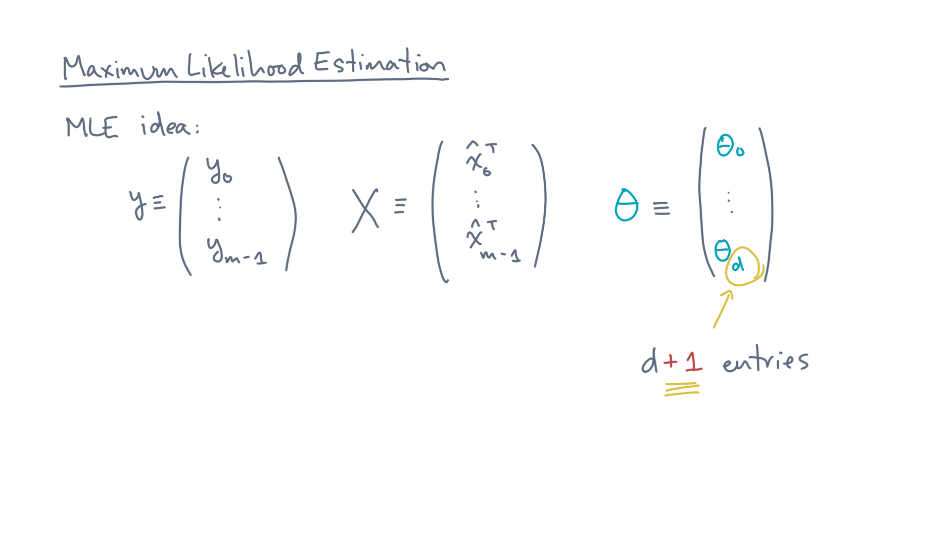
Notes:
Our convention is that it has d+1 entries.
That is, there are d predictors plus an additional constant.

Slide 12
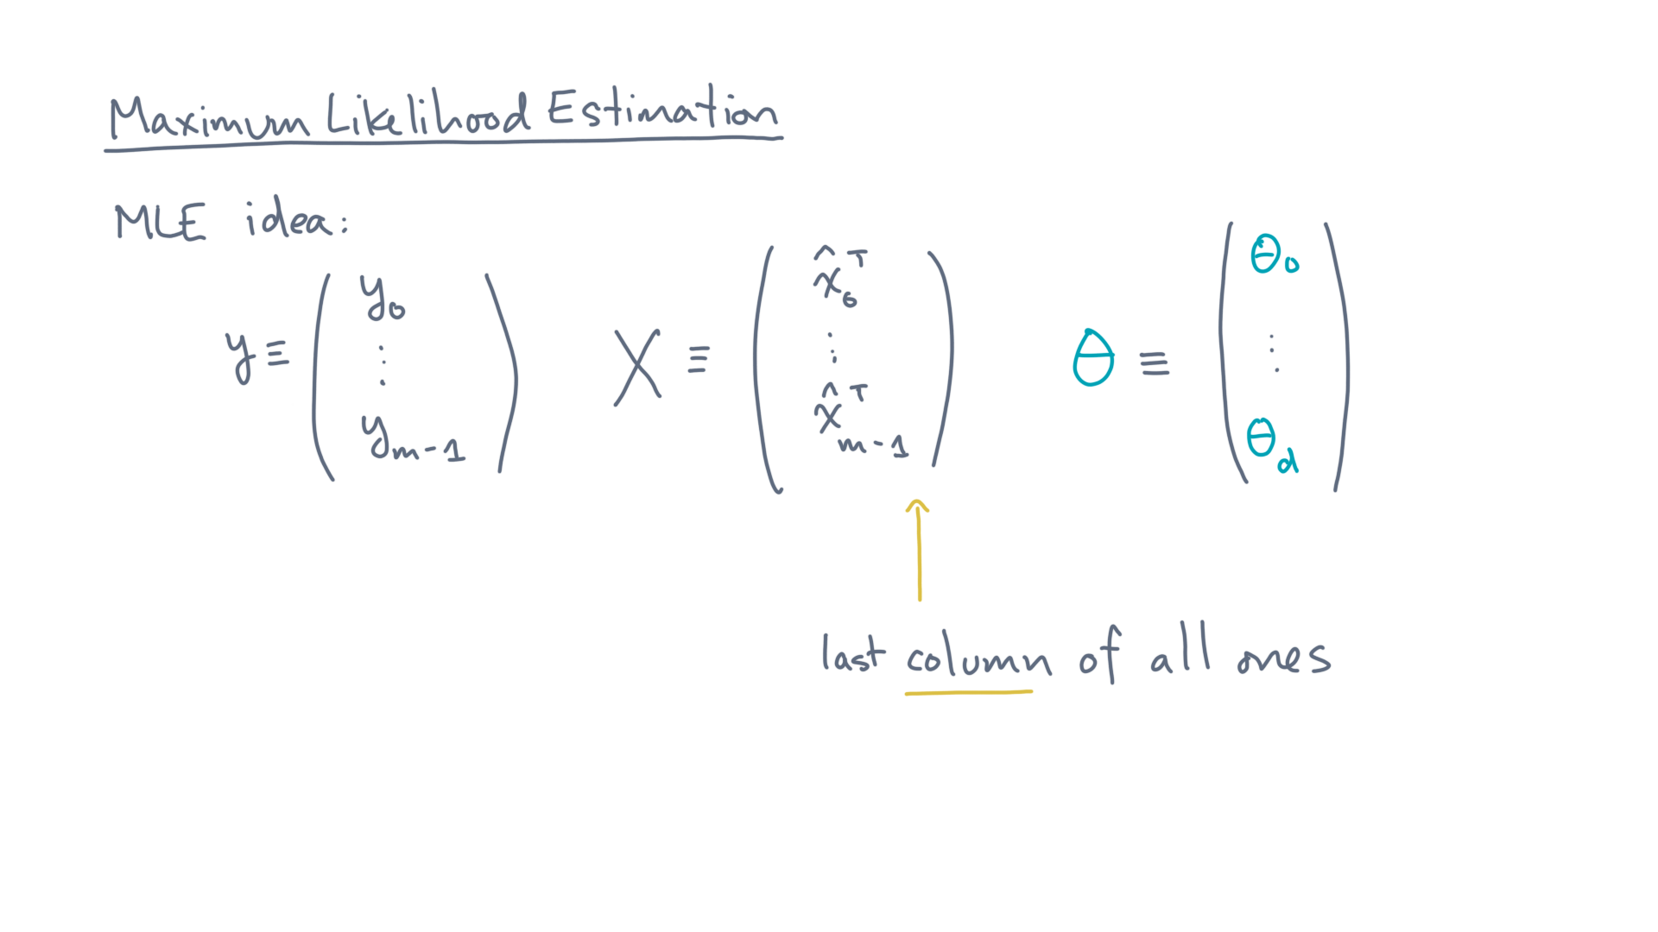
Notes:
Let’s further assume the convention that the last *column* of the data matrix X has all one values.

Slide 13
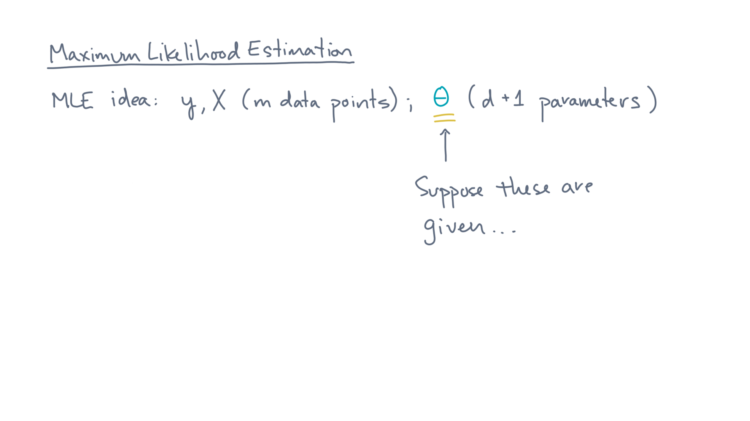
Notes:
Now, suppose someone gave you a model, meaning, they gave you “theta.”

Slide 14
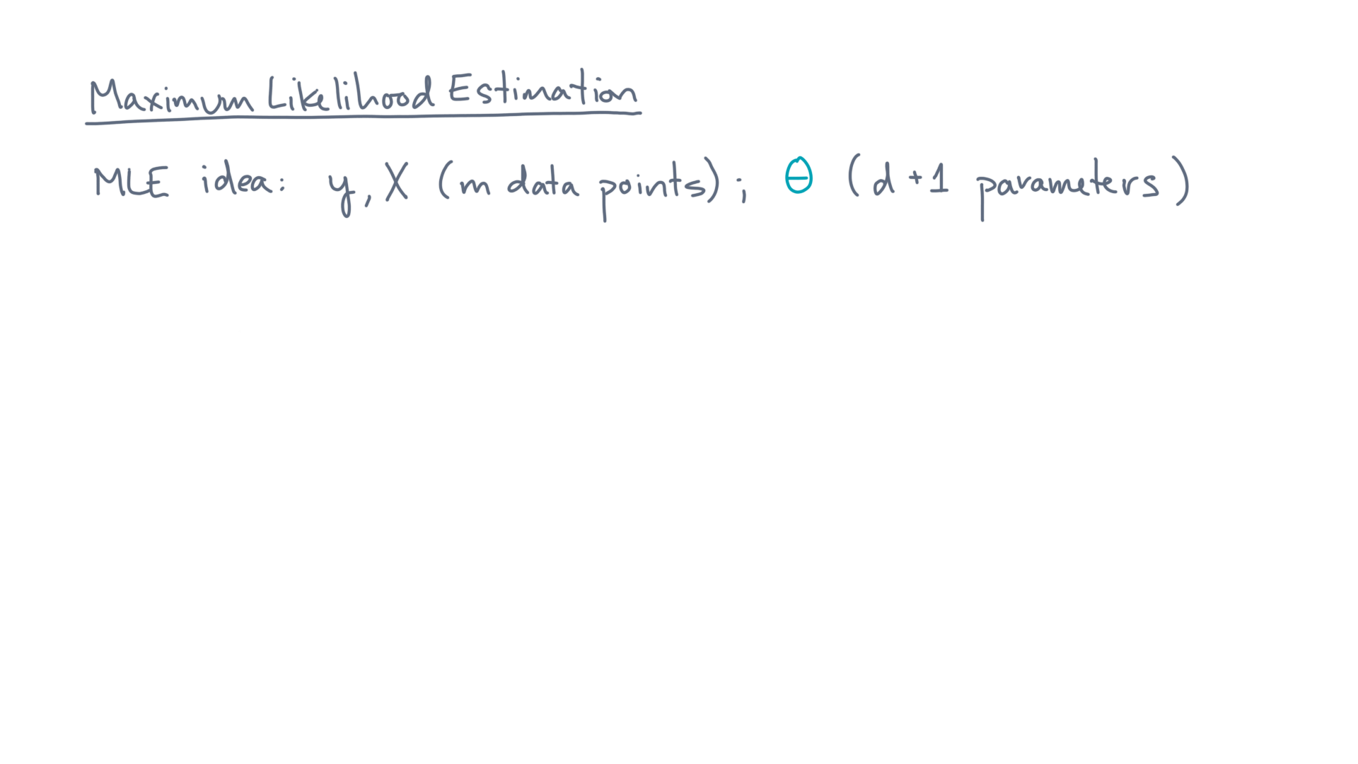
Notes:
You could ask the following question.

Slide 15
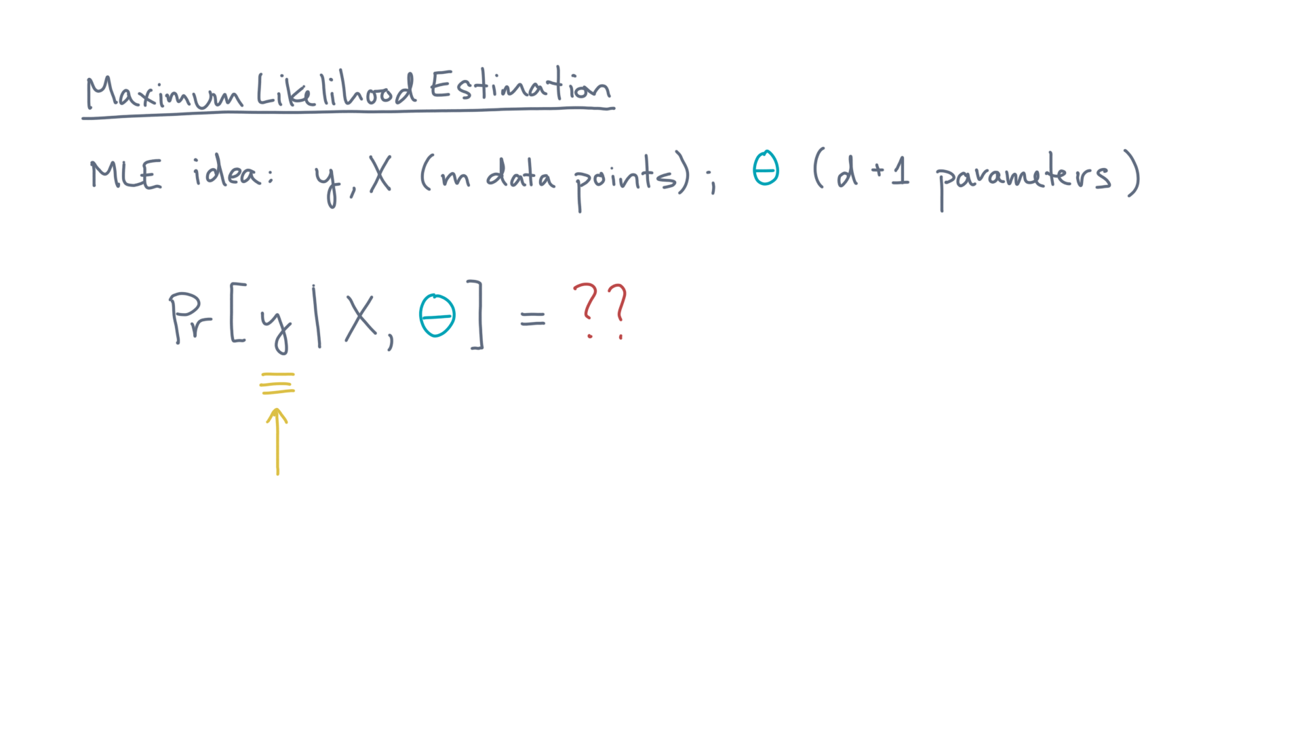
Notes:
What are the chances that we would have seen these particular labels, under this model?

Slide 16
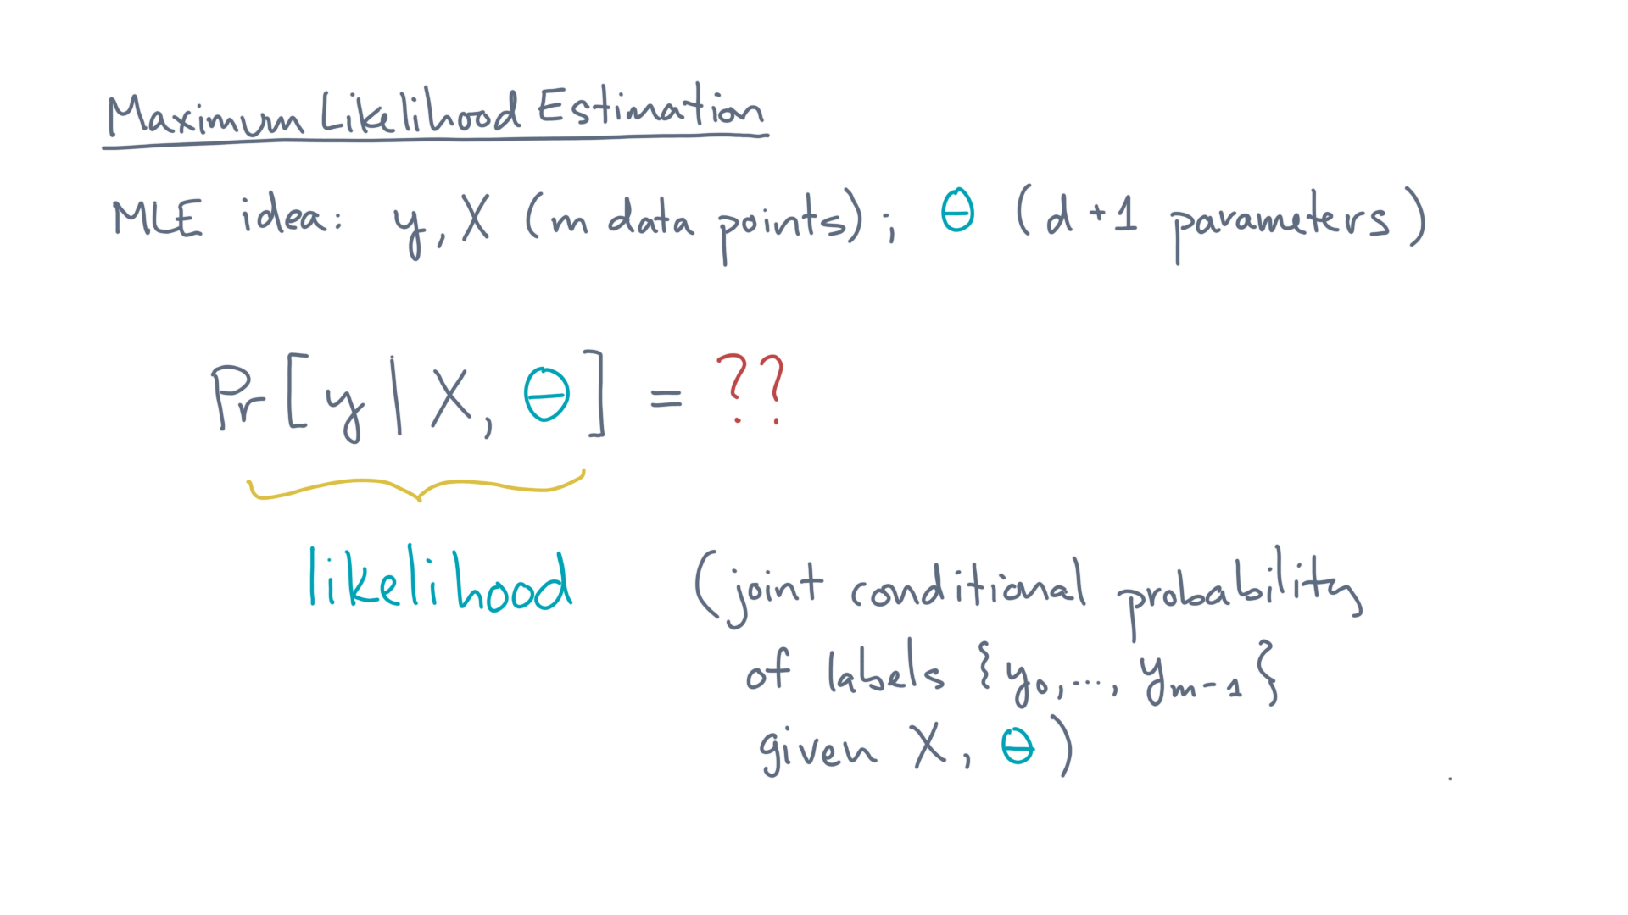
Notes:
We’ll refer to this probability as the “likelihood.”
That’s a shorthand for the joint, conditional probability of seeing the labels given the coordinates, X, and model parameters, theta.

Slide 17
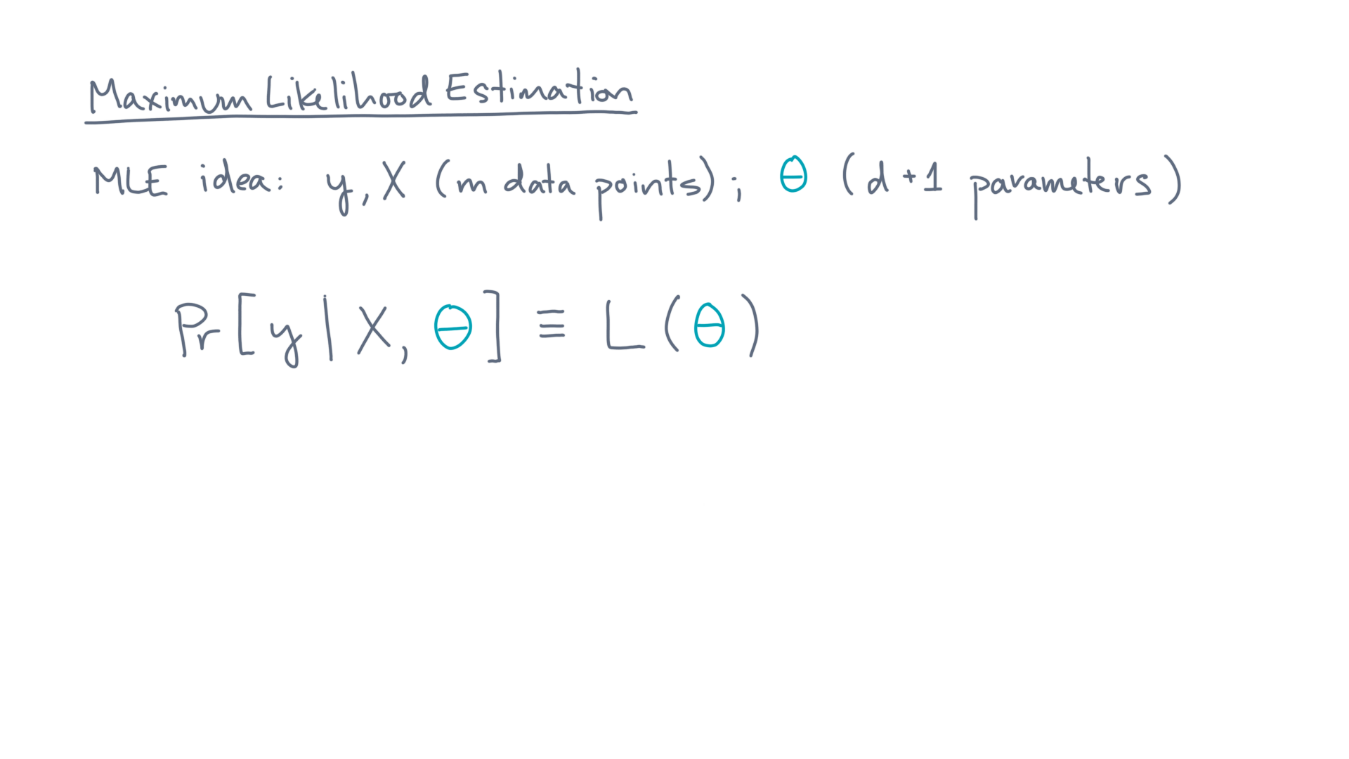
Notes:
Now, let’s think of the likelihood as a function of theta.

Slide 18
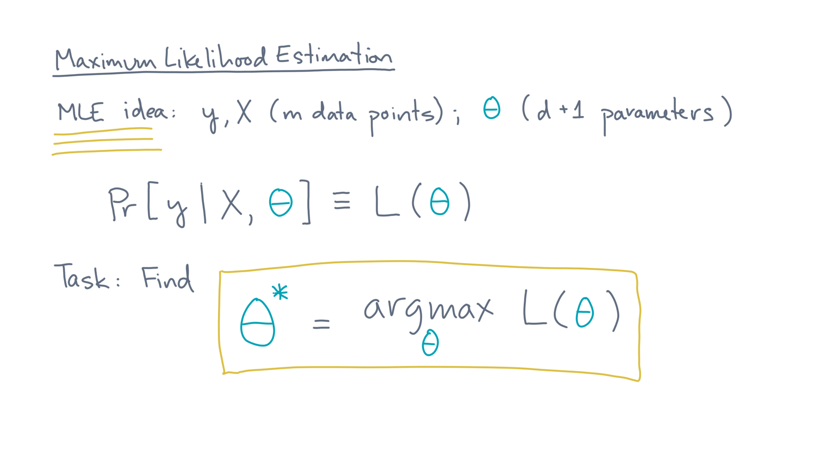
Notes:
The task of maximum likelihood estimation is to find the “best” model, meaning the one that maximizes the likelihood!
So how do we do that?

Slide 19
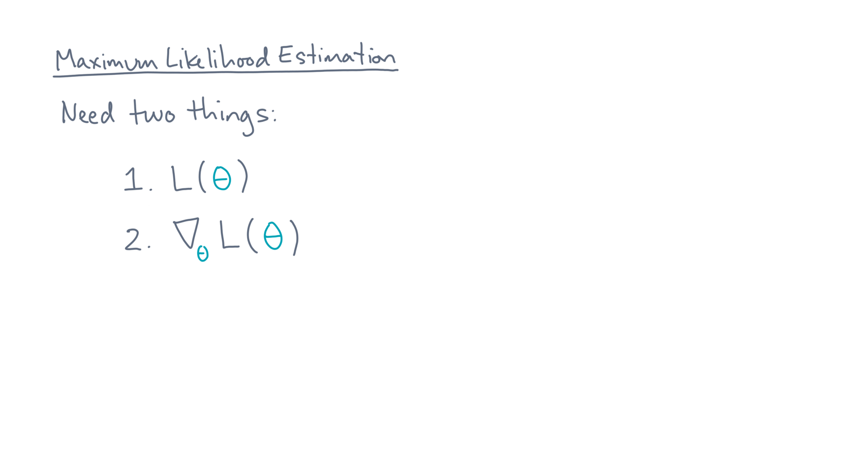
Notes:
You’re going to need two things.

Slide 20
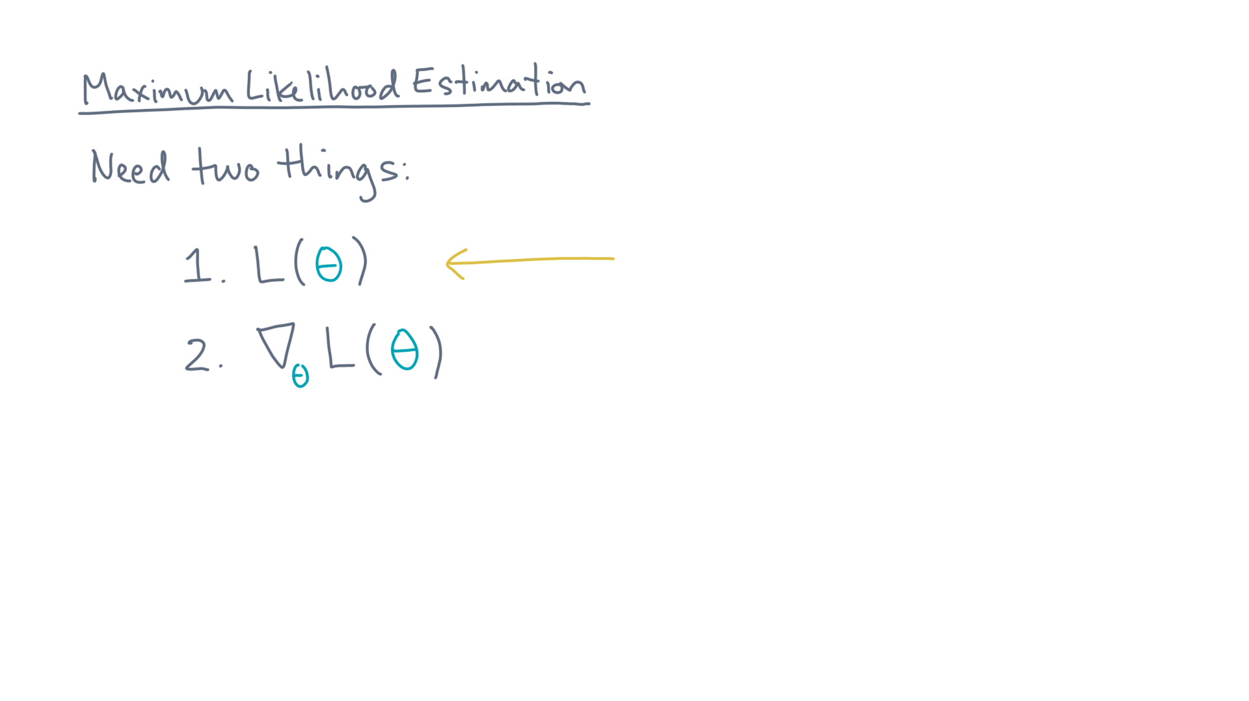
Notes:
First, you need the likelihood.

Slide 21
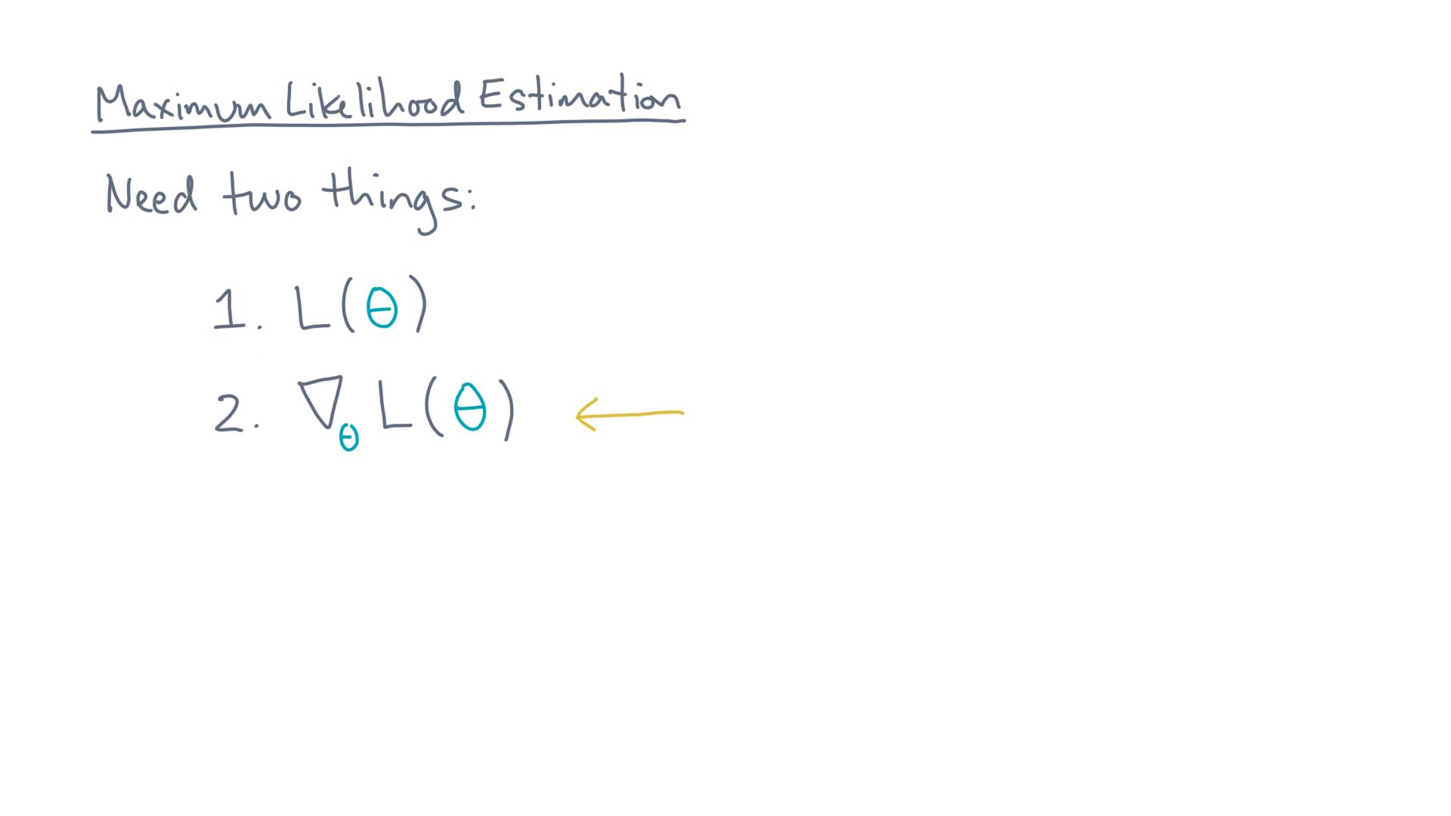
Notes:
And, since you want to maximize it, you’ll need its gradient.

Slide 22
Notes:
Let’s start with the likelihood.

Slide 23
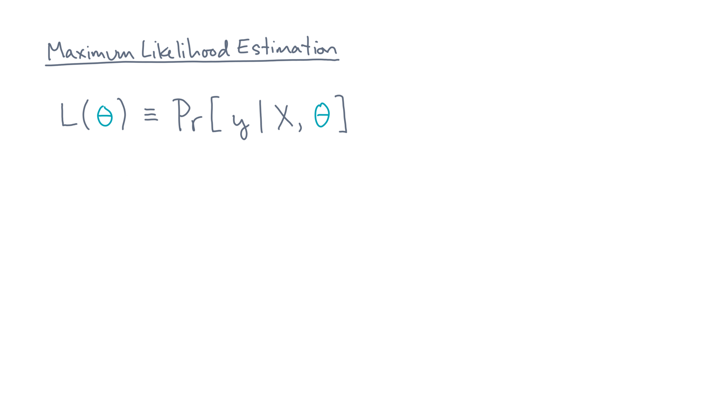
Notes:
Recall its definition as the joint conditional probability of the labels, given the coordinates and theta.

Slide 24
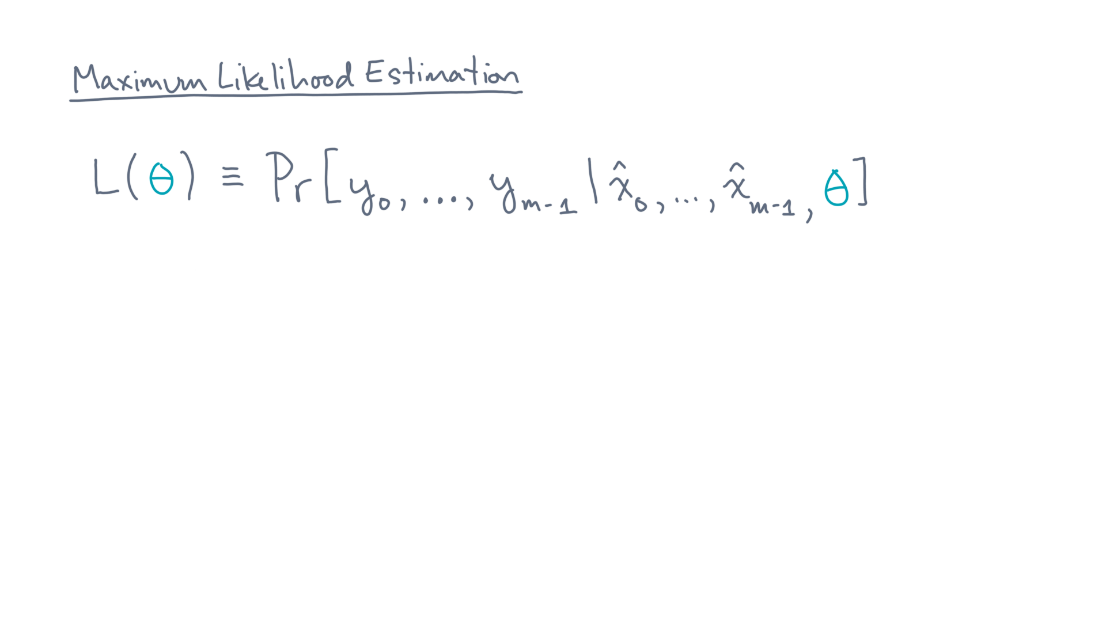
Notes:
Let’s consider the likelihood in terms of the individual observations.
Now here is our first simplifying assumption.

Slide 25
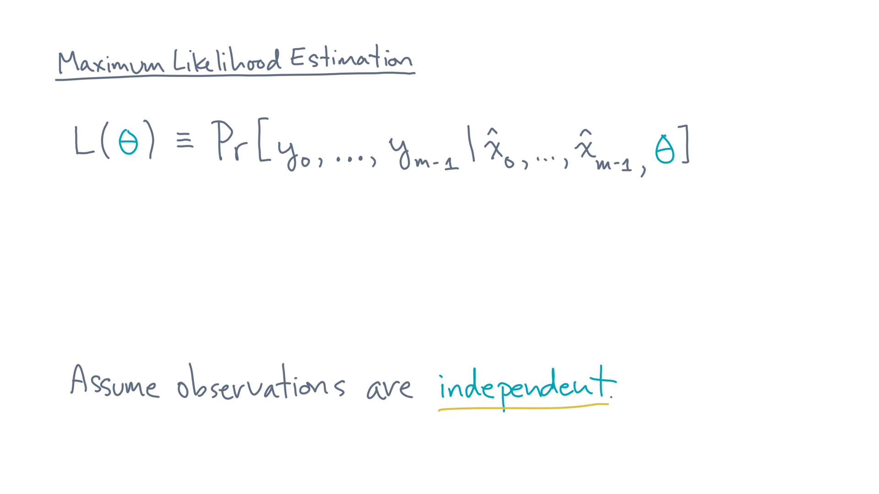
Notes:
Assume that the observations are independent.

Slide 26
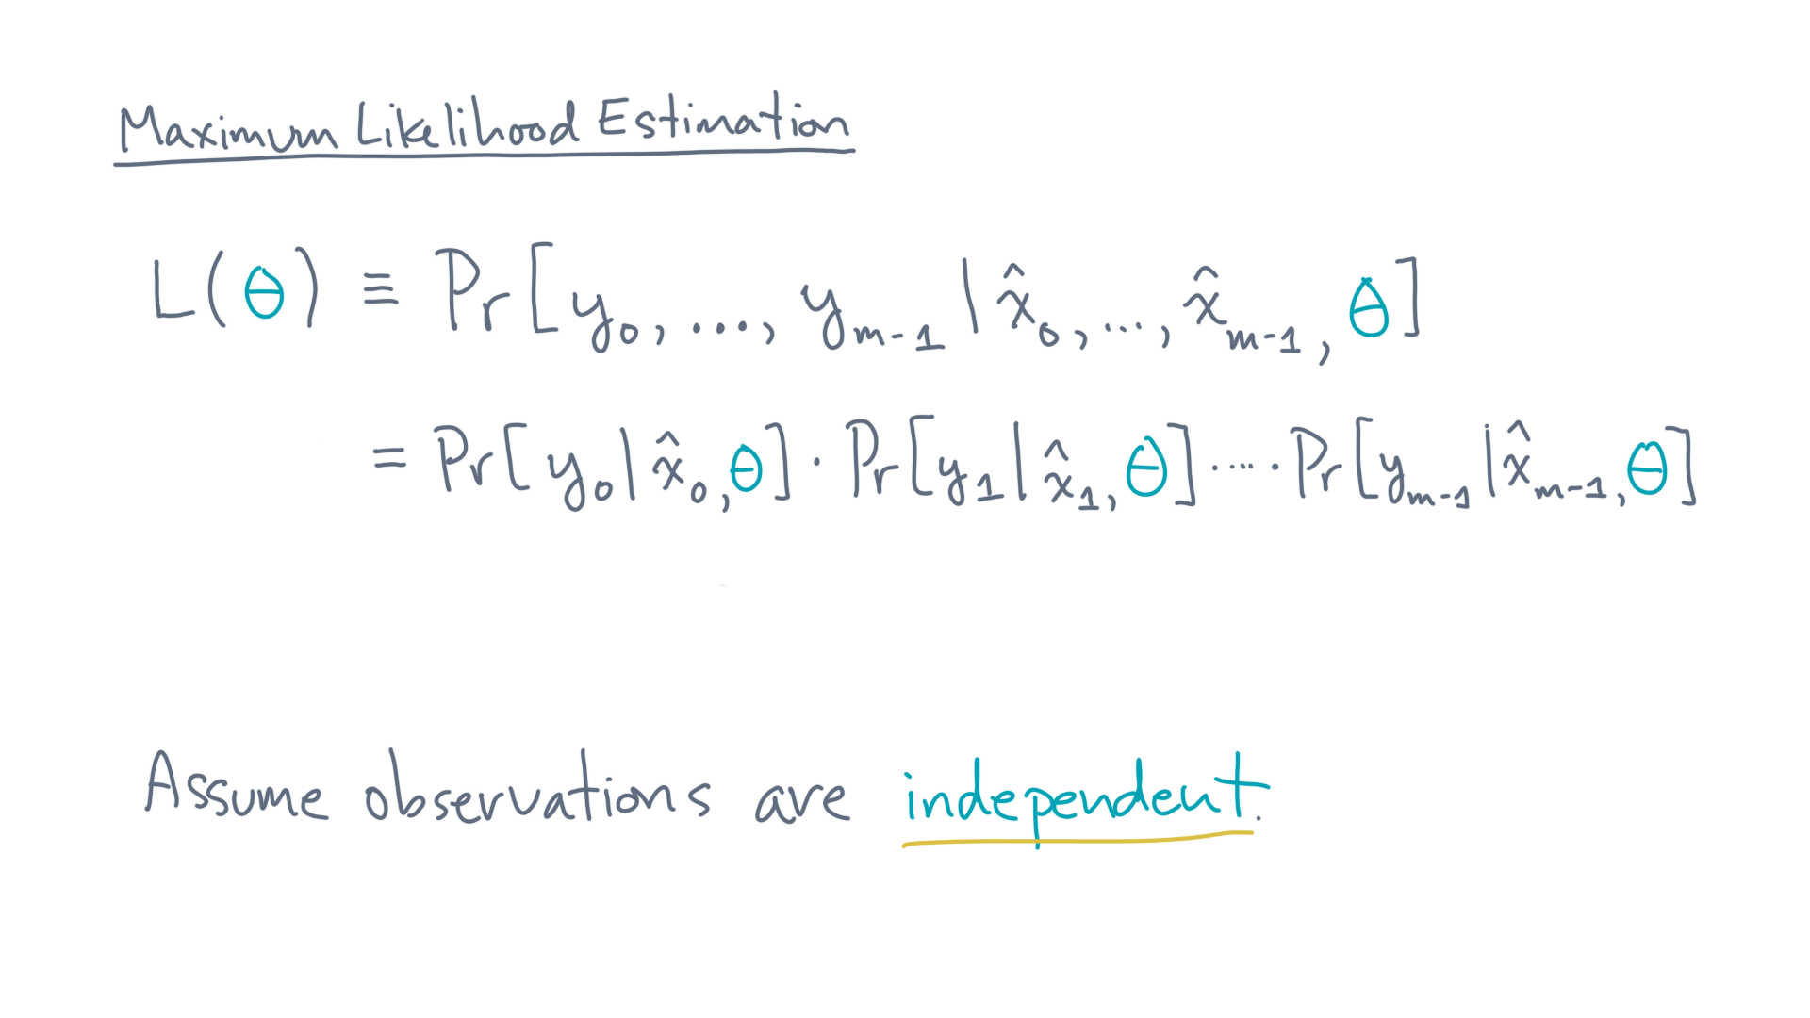
Notes:
In that case, you can factor the joint probability into the product of per-observation probabilities.

Slide 27
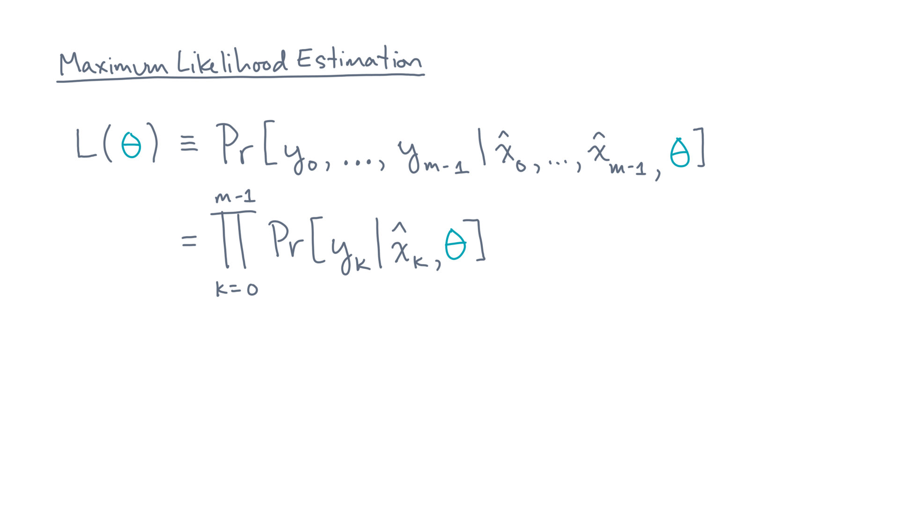
Notes:
Let’s rewrite that product more compactly as the product from k equals 0 to m-1 of the probability of y-k given x-hat-k and theta.

Slide 28
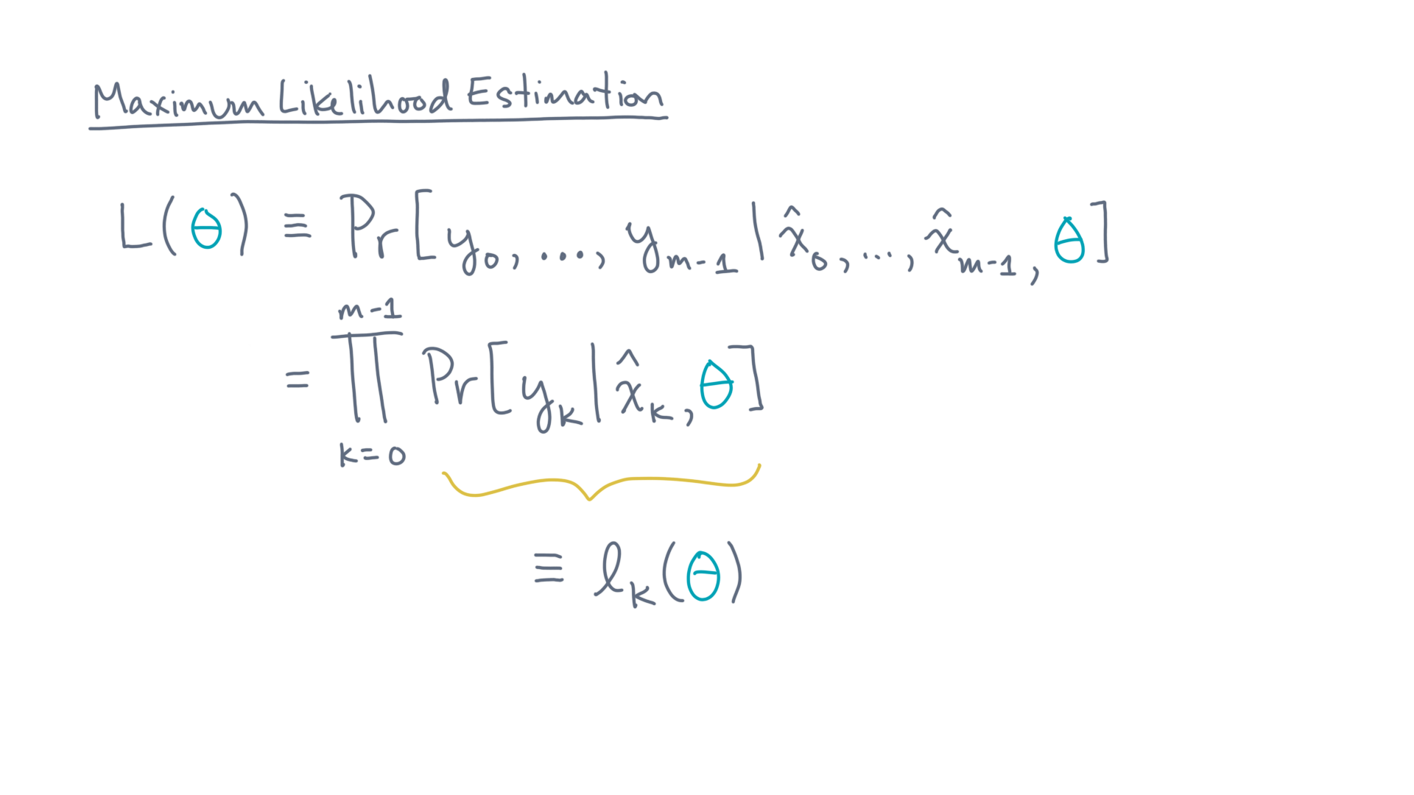
Notes:
Let’s also use the shorthand, little-ell-kay of theta to denote those individual probabilities.

Slide 29
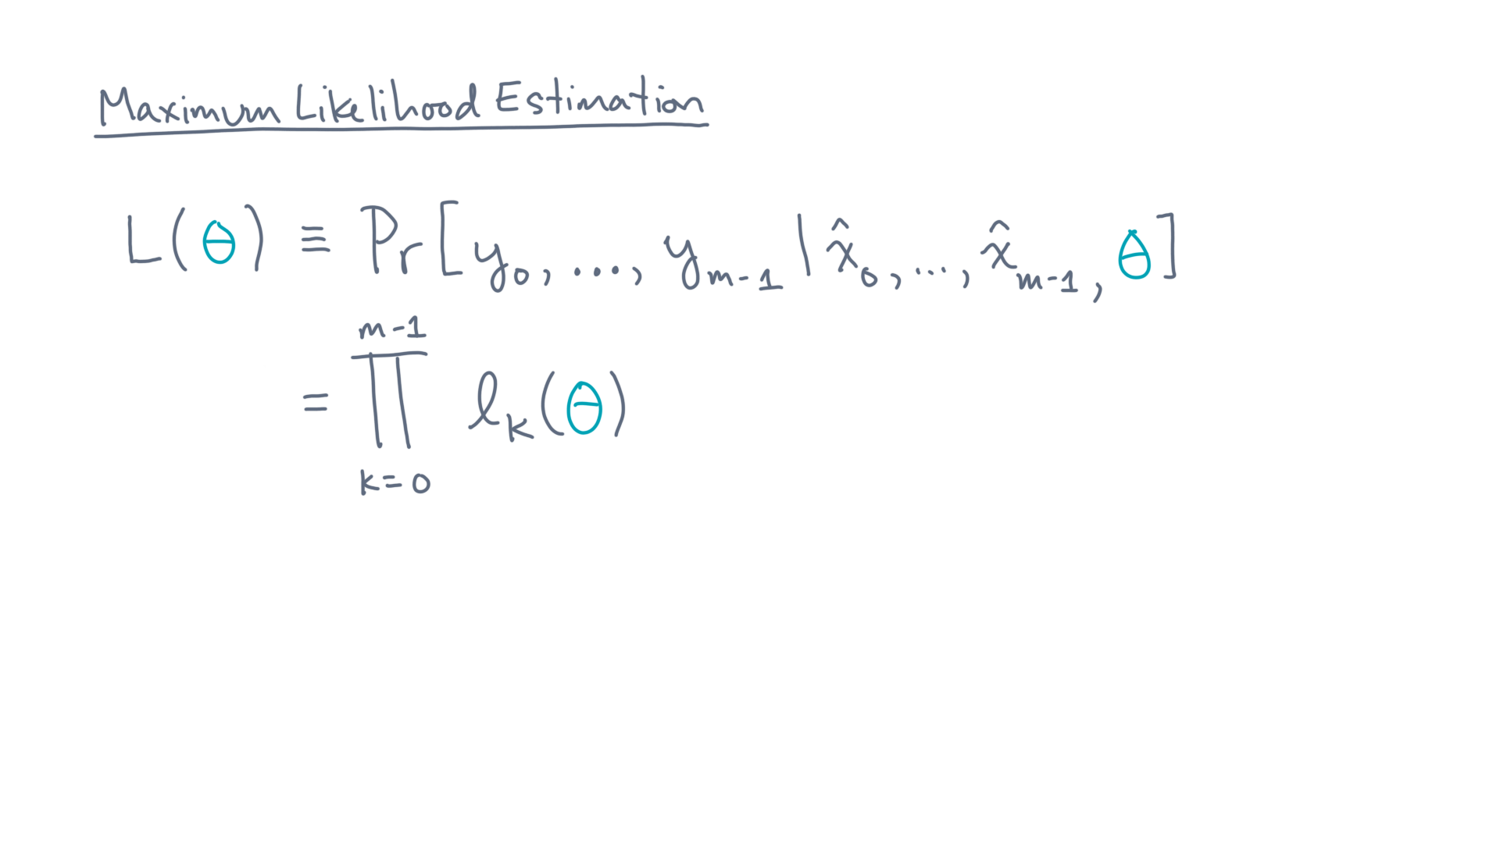
Notes:
Now, eventually we want to maximize the likelihood.

Slide 30
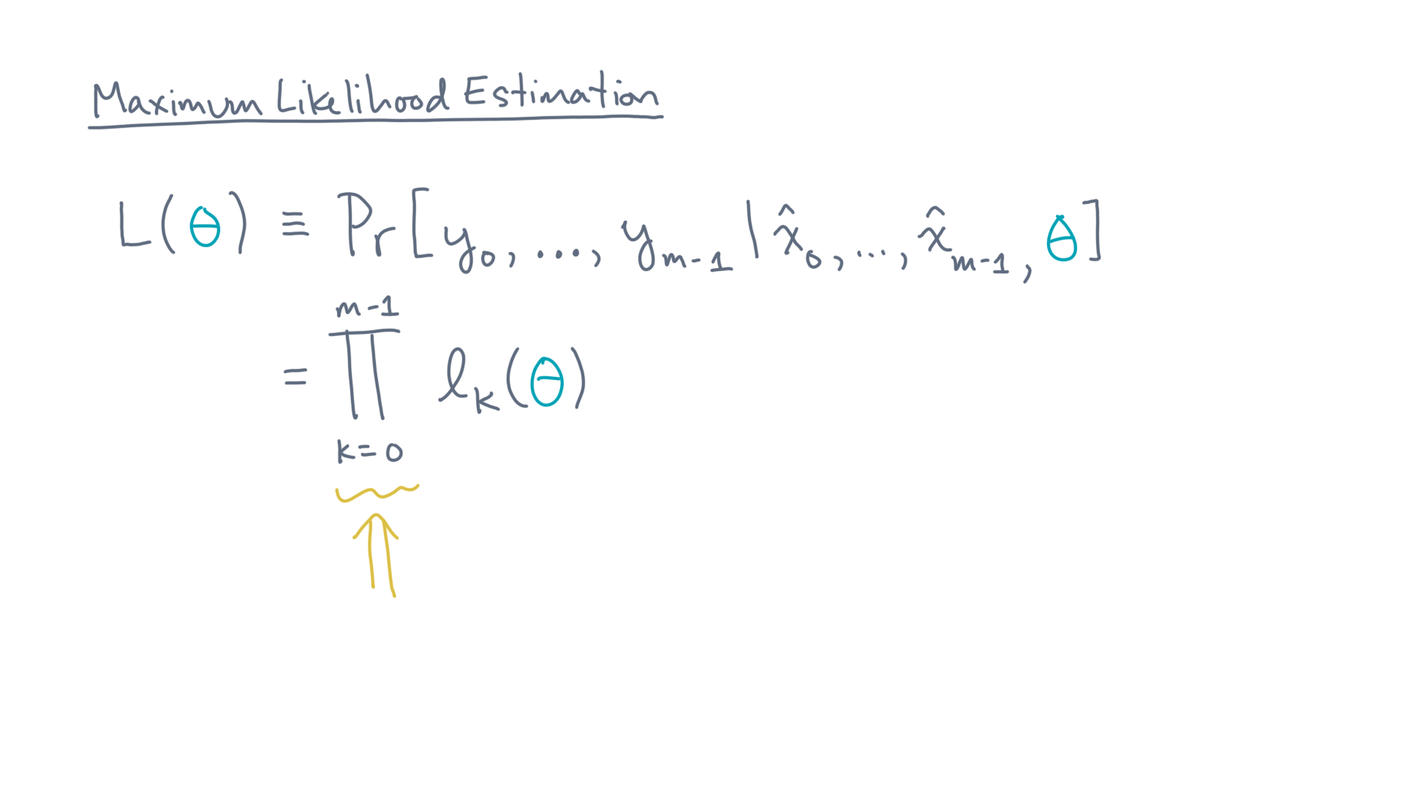
Notes:
It turns out that trying to do so by directly maximizing this product is hard, mathematically speaking.
There are at least a couple reasons.

Slide 31
Notes:
One has to do with taking derivatives of products, and another with the fact that these probability values are tiny numbers that, when multiplied, become even tinier.
Does that make sense?
You might try to think about what I just said in terms of things you’ve seen and learned in other parts of this course.

Slide 32
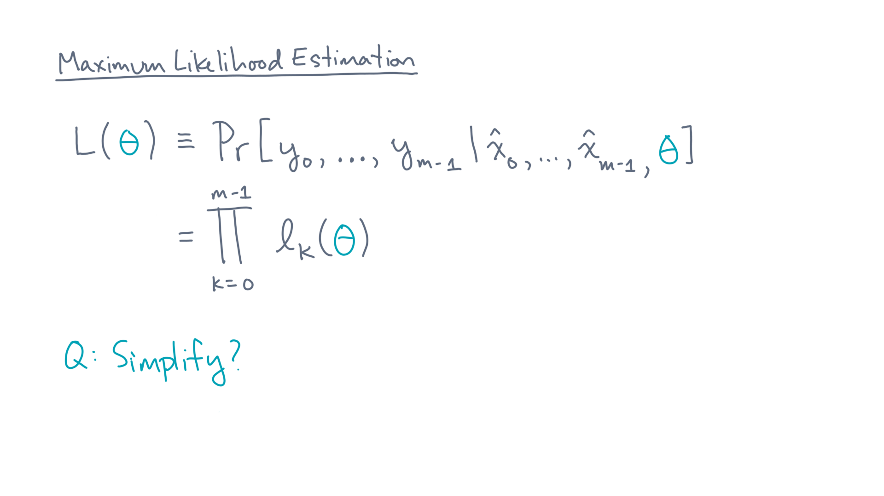
Notes:
So, what’s next?

Slide 33
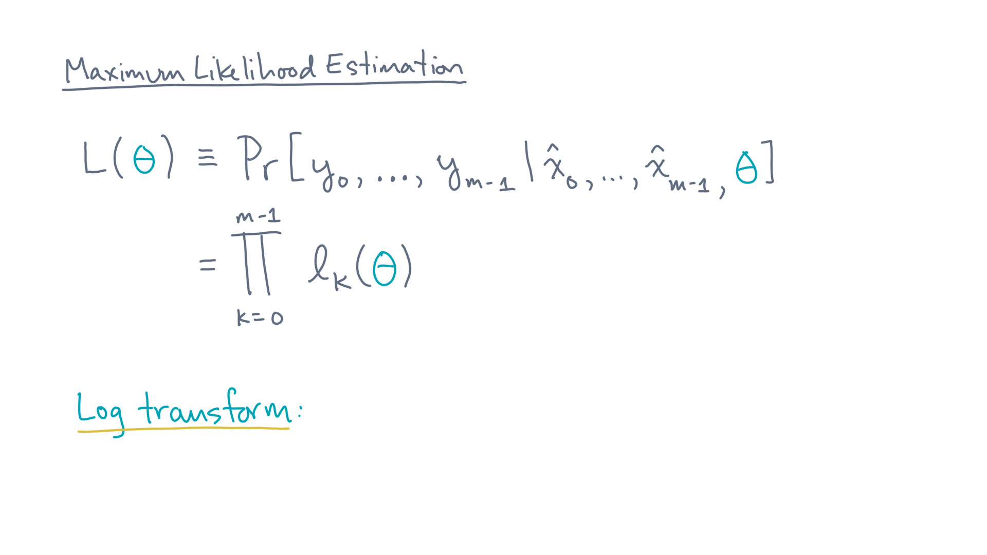
Notes:
One idea is to use logarithms to transform this problem into an equivalent one.
This idea exploits two properties of logs.

Slide 34
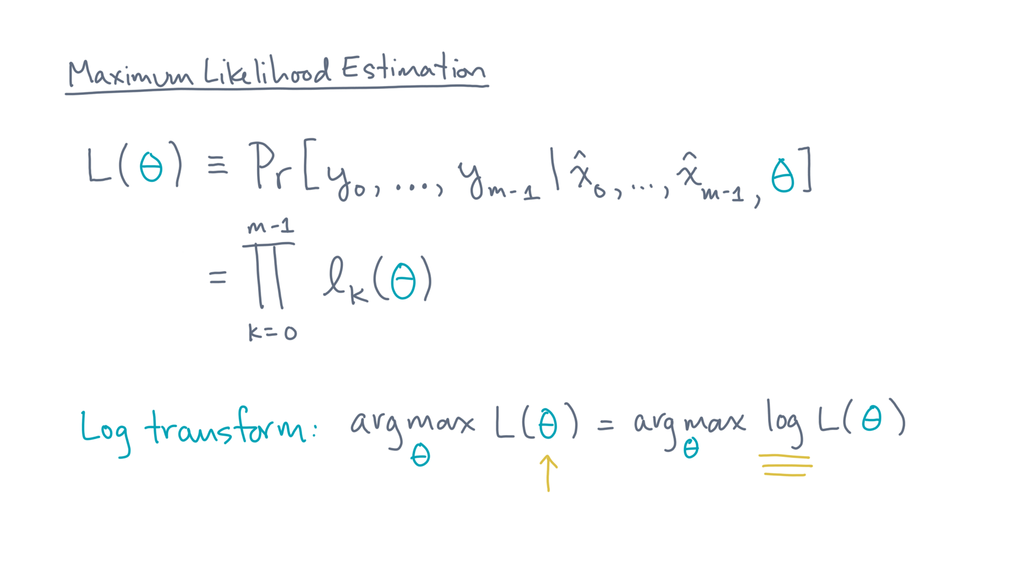
Notes:
The first is that the optimal theta is preserved when you take the log of the likelihood.
That’s essentially because logs are monotonic, so it can’t change where the maximum value occurs.

Slide 35
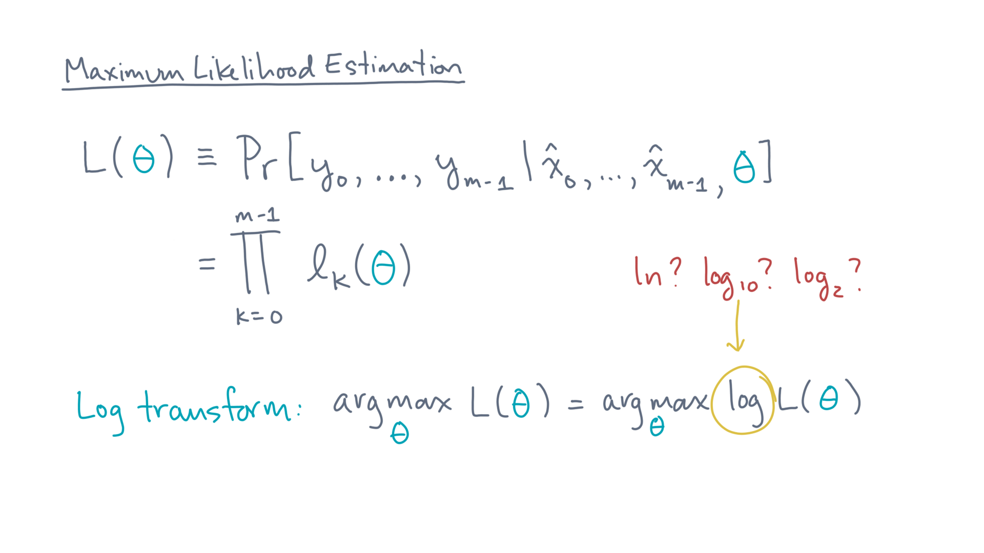
Notes:
By the way, I keep saying “logarithm” but I’m not specifying the base. That is, do I mean the natural log? Log base 10? Log base 2?
In this context, it doesn’t matter because they are all within a constant factor of one another.

Slide 36
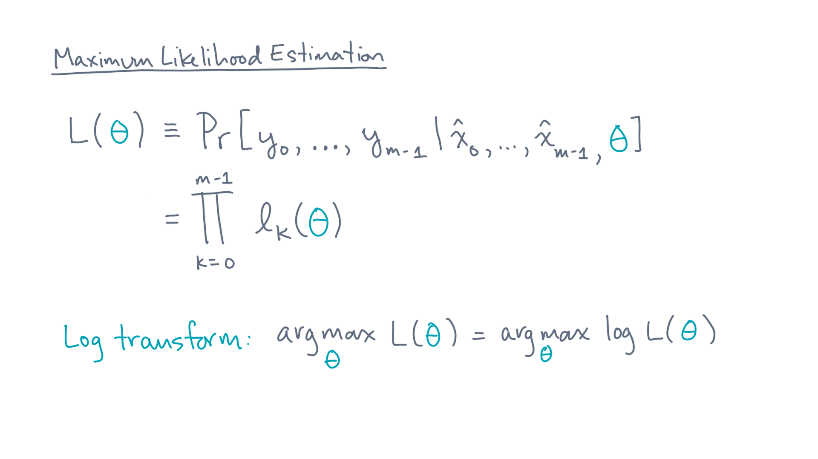
Notes:
So, I’ll leave it unspecified – and if you need a concrete choice, go with the natural log.

Slide 37
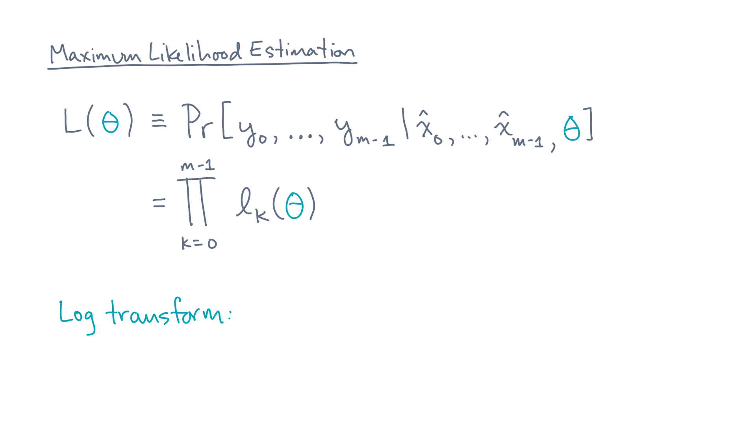
Notes:
Now here is the other useful property of logs for this problem:

Slide 38
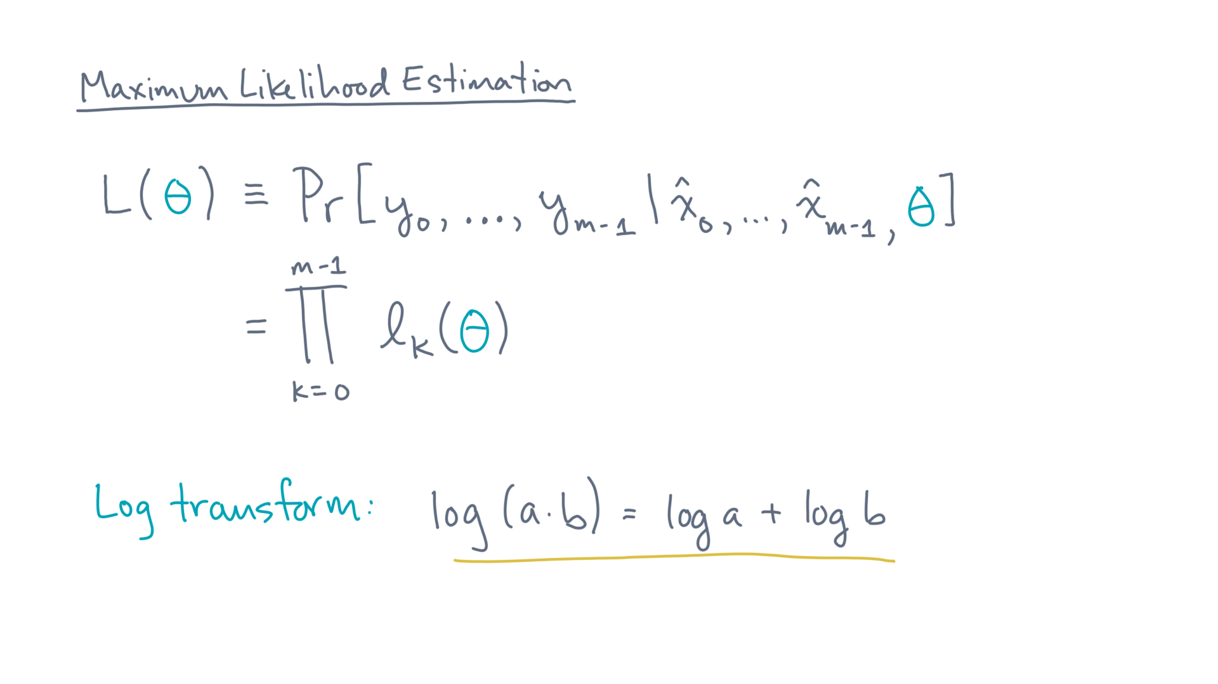
Notes:
The log(a times b) is the sum of log(a) and log(b).

Slide 39
Notes:
So, what does this all mean?

Slide 40
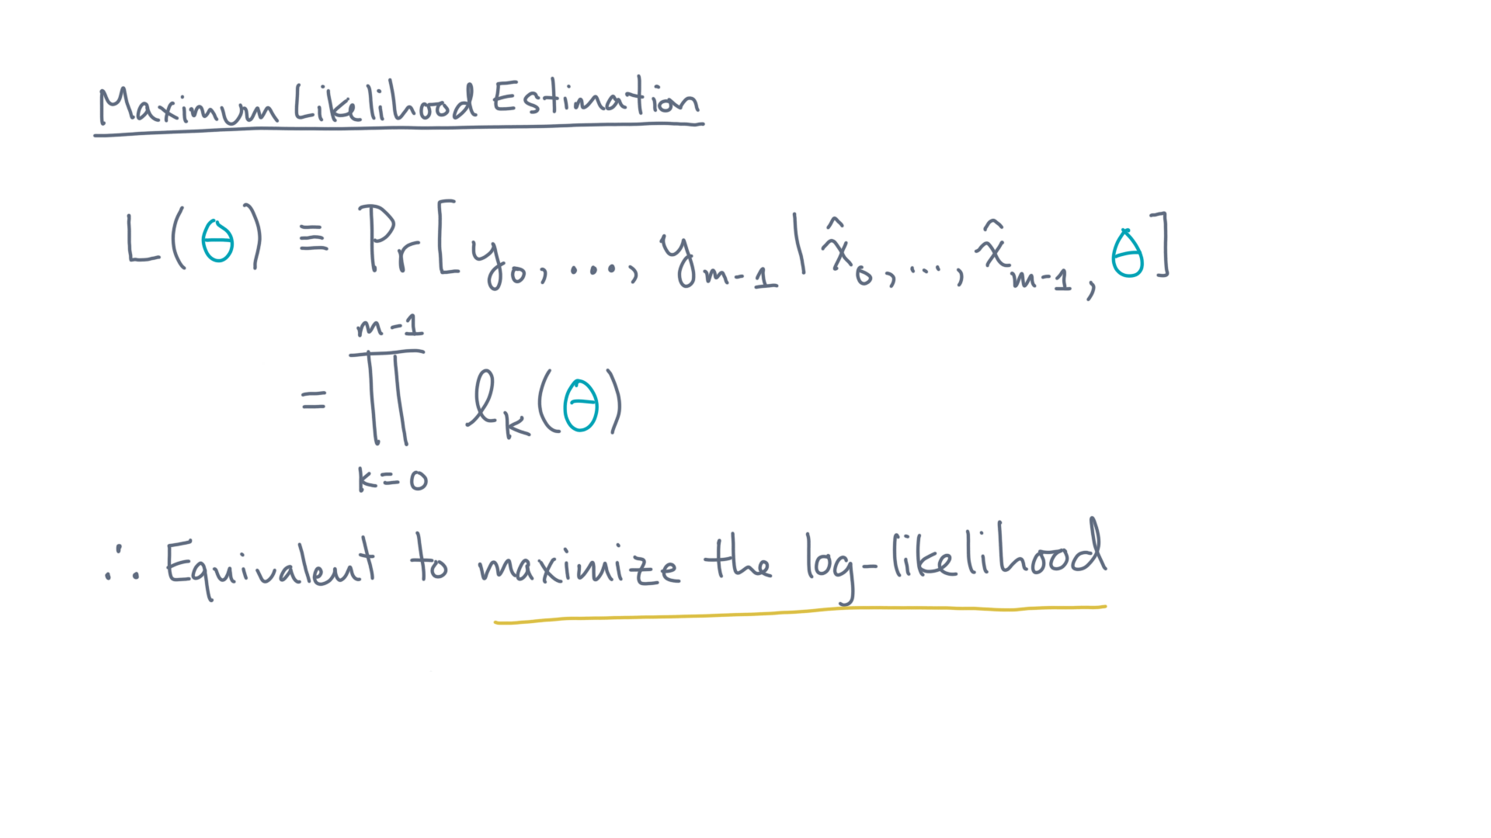
Notes:
Instead of maximizing the likelihood, we’ll get the same answer if we instead maximize the *log* of the likelihood.

Slide 41
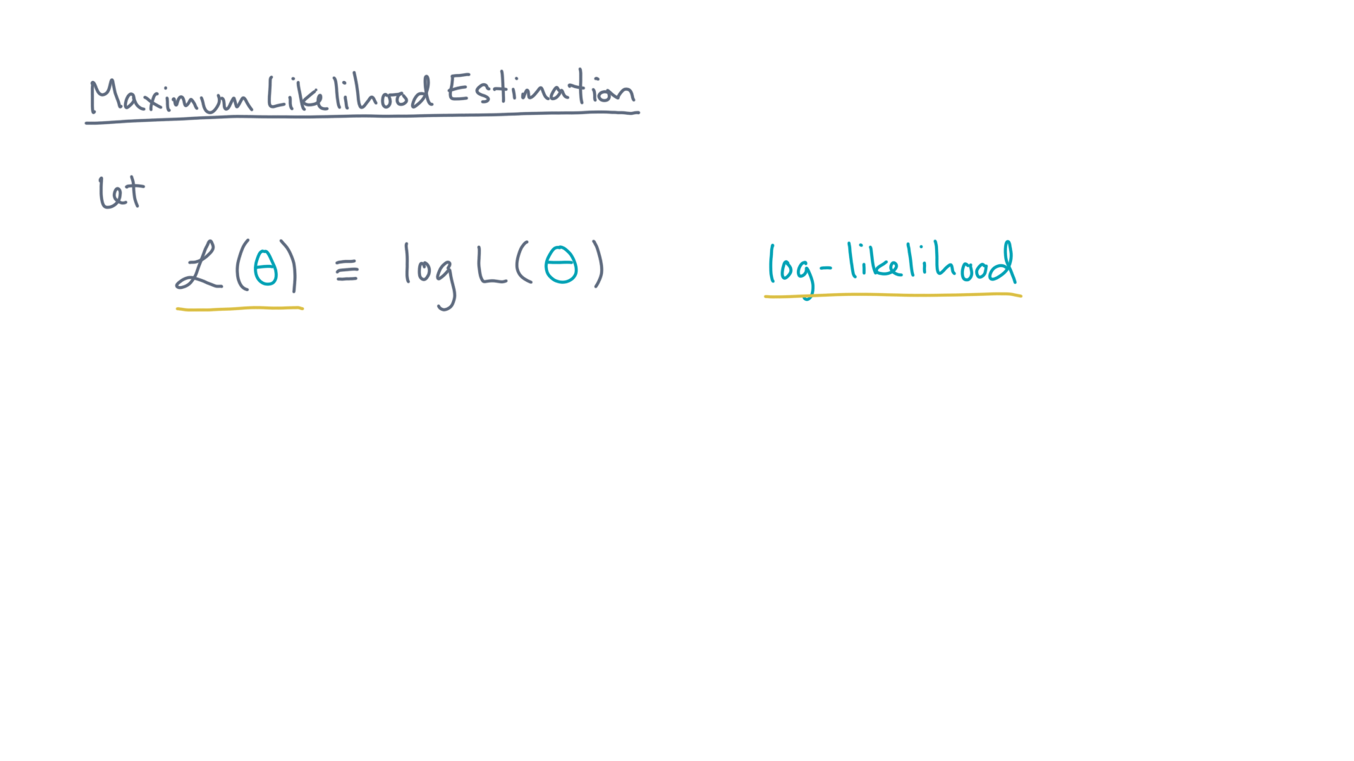
Notes:
So, let script-ell of theta be the log of the likelihood, ell of theta.

Slide 42
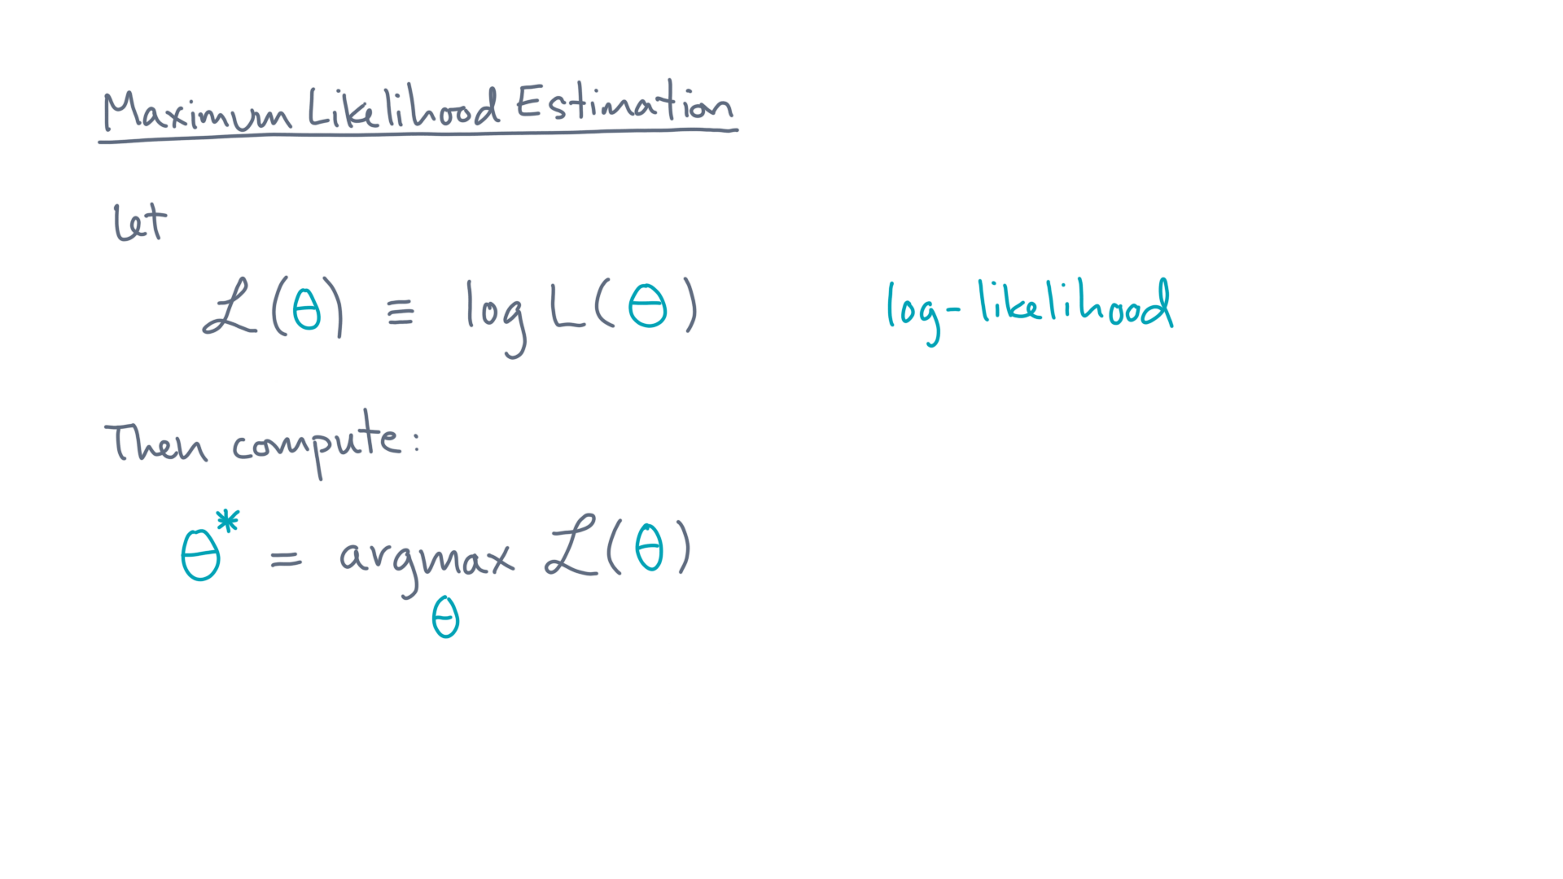
Notes:
Then we want to maximize the log-likelihood.

Slide 43
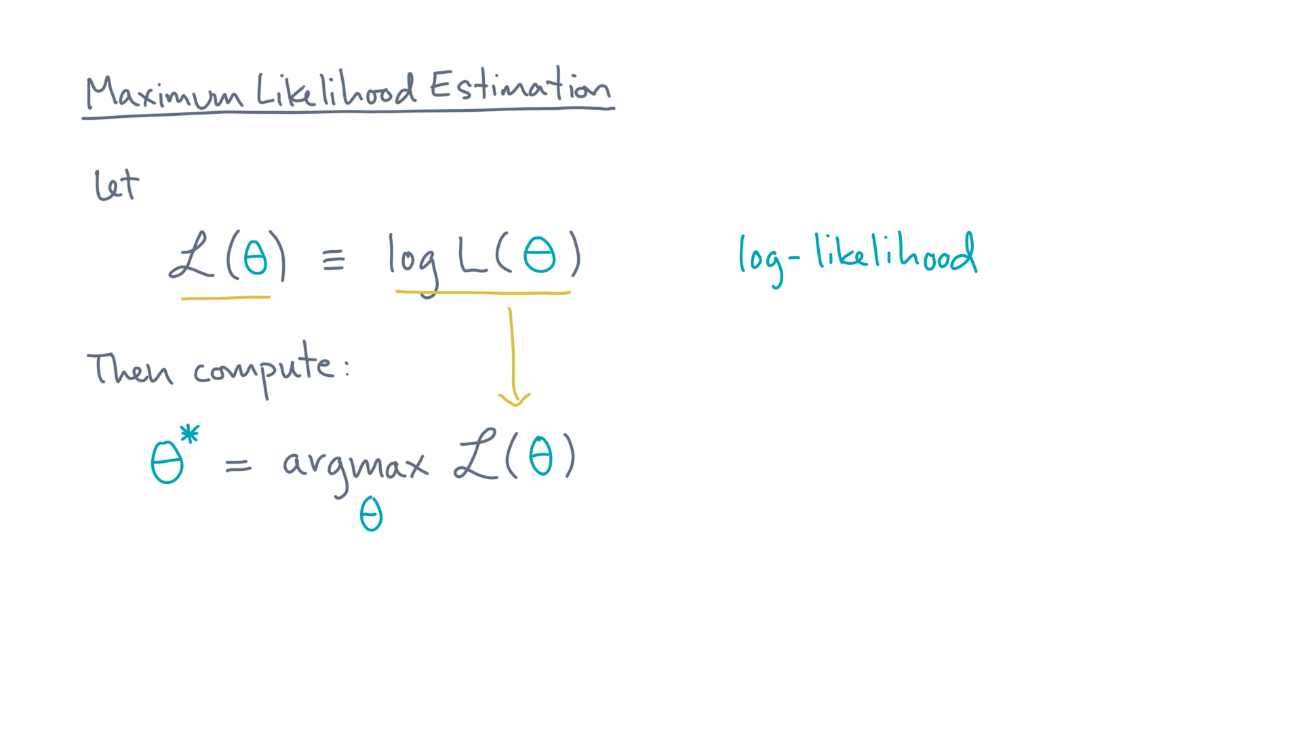
Notes:
Next, recall the definition of the log-likelihood, the likelihood, and substitute that:

Slide 44
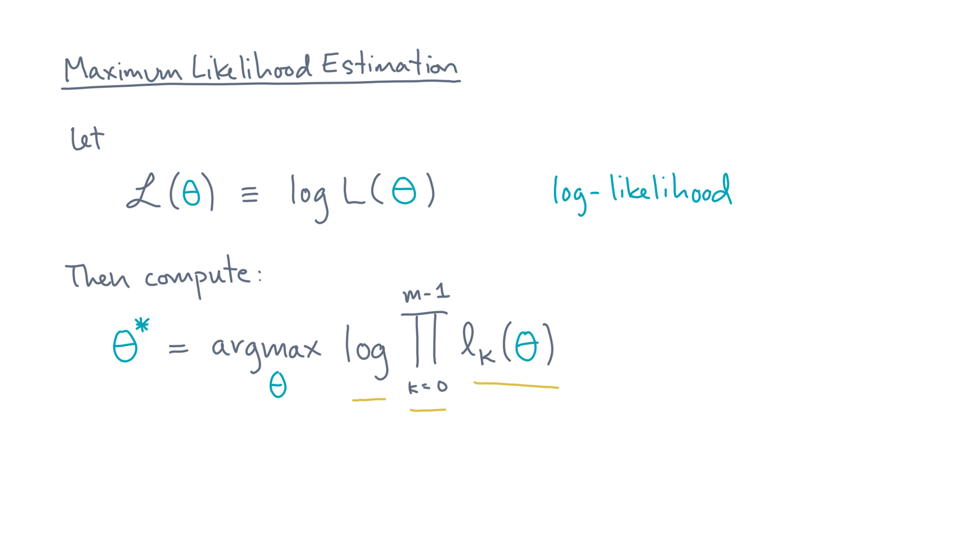
Notes:
That’s the log of the product of the individual likelihoods, ell-kay-of-theta.

Slide 45
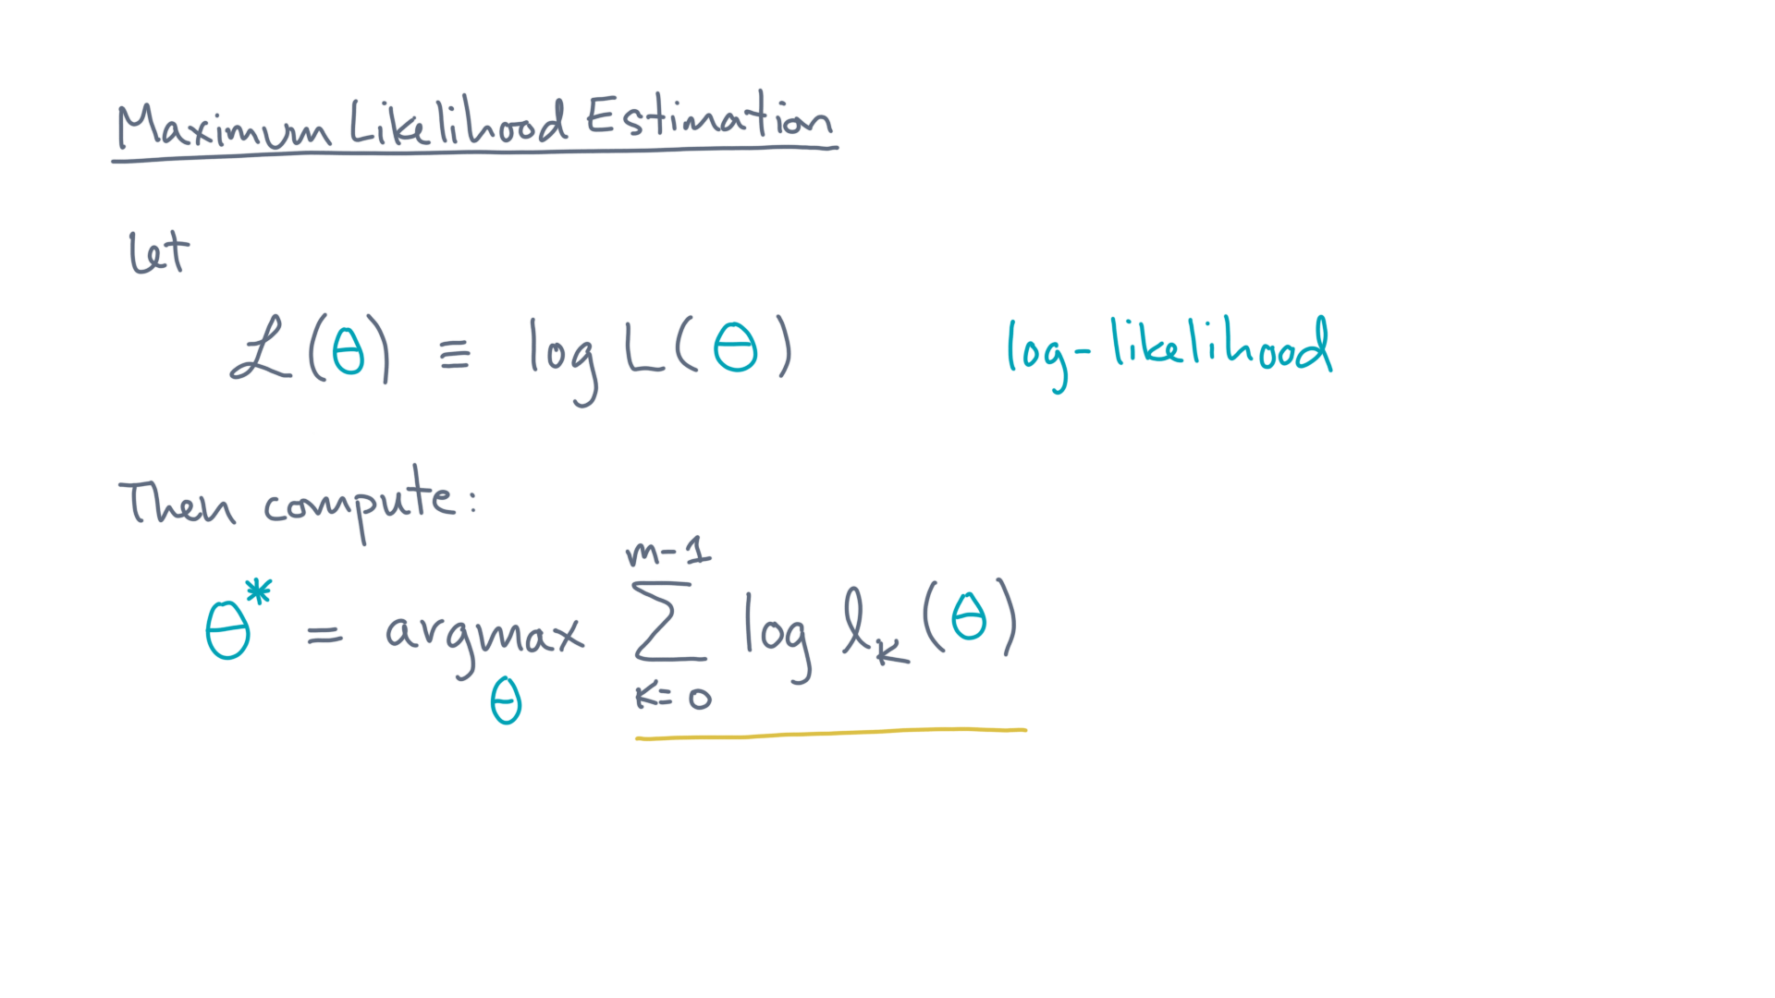
Notes:
Which, in turn, is the sum of the logs of ell-kay-of-theta.

Slide 46
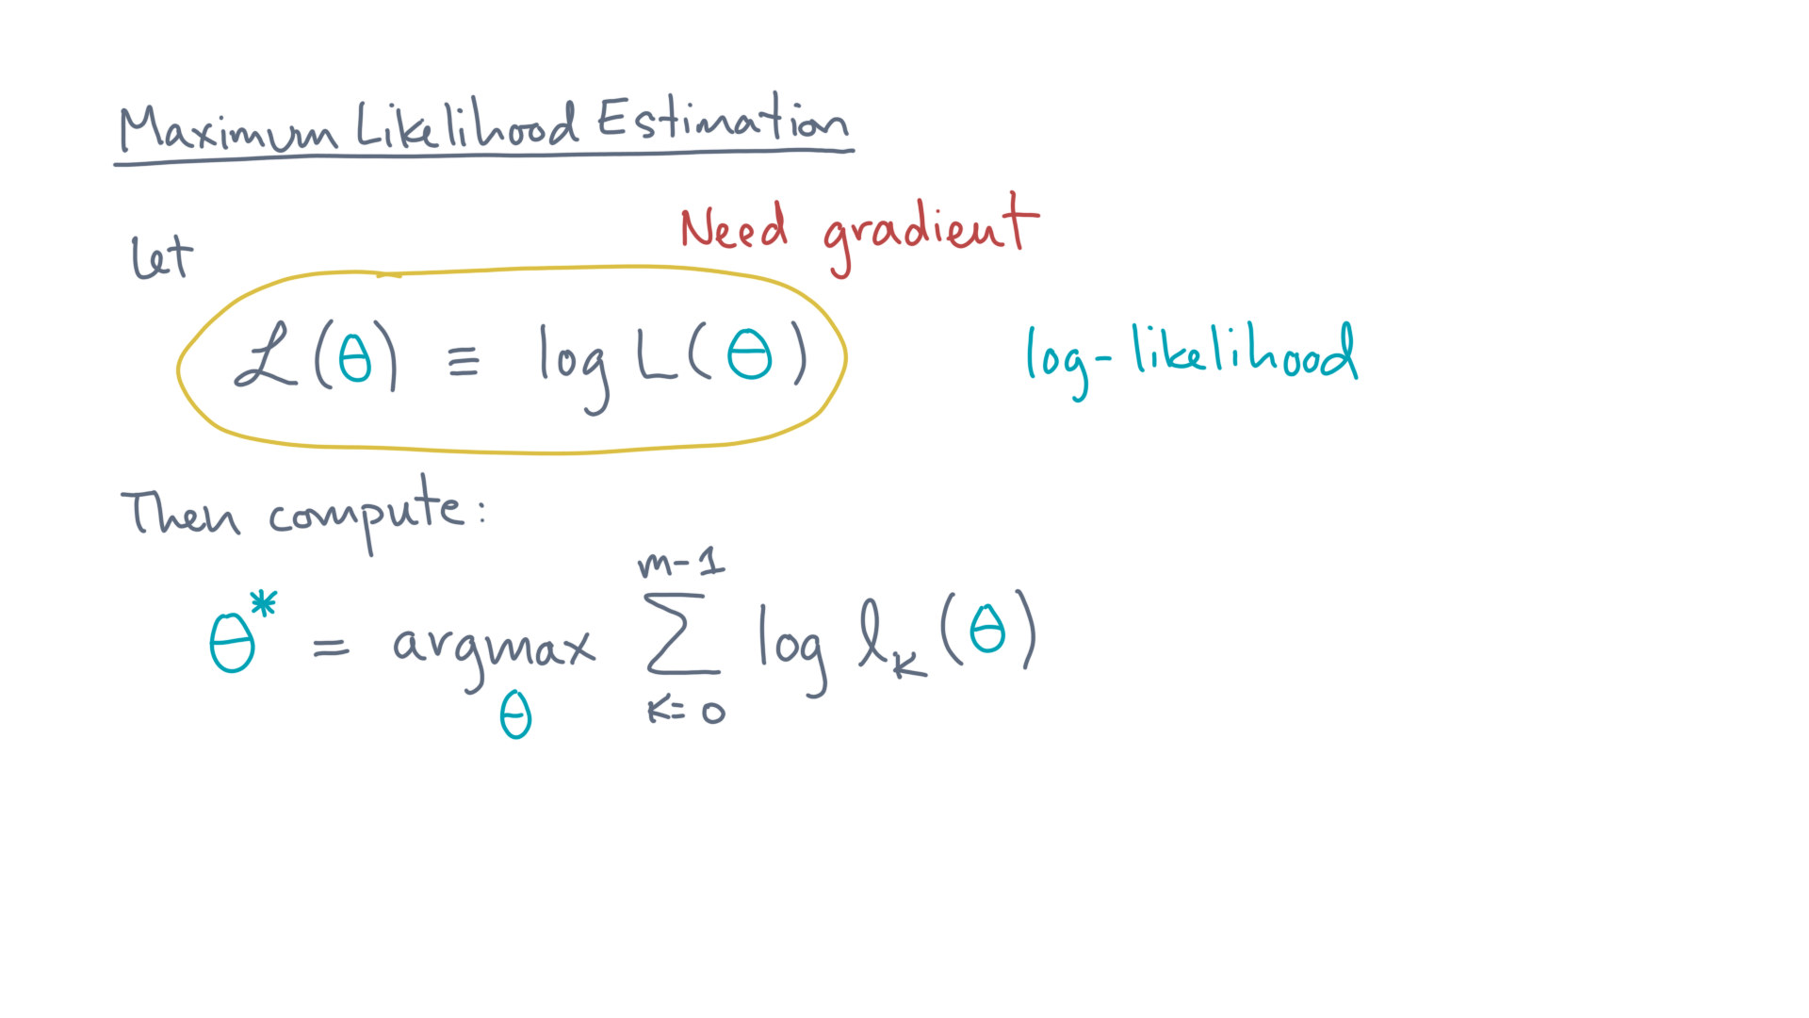
Notes:
Now, eventually we are going to need the gradient of the log-likelihood.

Slide 47
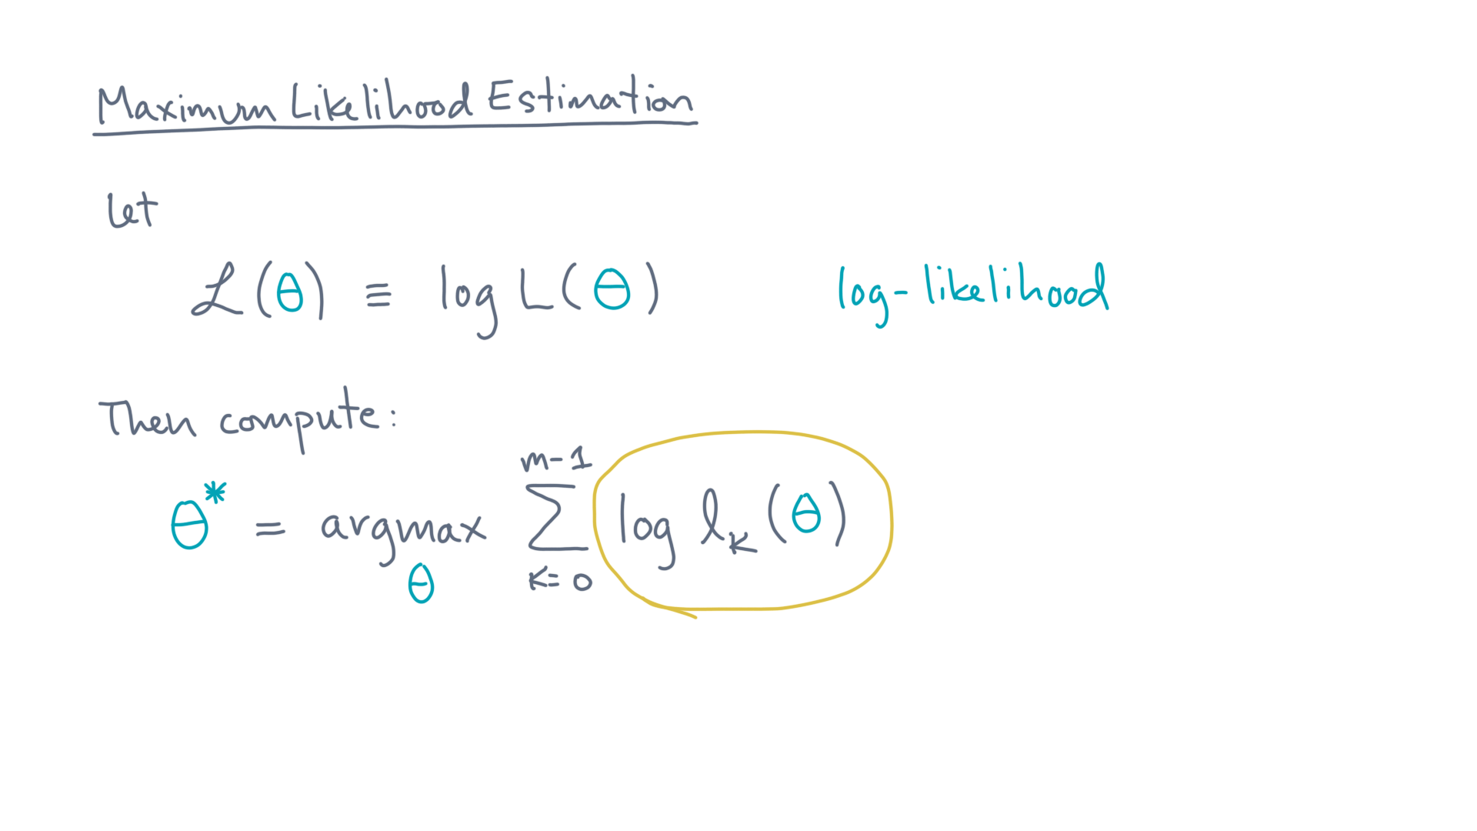
Notes:
That in turn means we’ll need to compute the gradient of this object, log of ell-kay-of-theta.
So that’s what we’ll need to do next.

Slide 48
Notes:
Right now, let’s take stock of where we are so far on the classification task.
At the start of this lesson, we said we wanted to fit a logistic classifier, with a linear discriminant, to our data.
So, we needed a way to define the “best” linear discriminant, meaning the best line that separates the classes.

Slide 49
Notes:
To define best, we discussed a criterion called the likelihood, which is the probability of seeing the data, given a line.
Our computational task then becomes one of maximizing the likelihood.
And for technical reasons, we decided it might be easier to maximize the log-likelihood, instead of the likelihood directly.

Slide 50
Notes:
Got it?
It not, I think this is a good place to pause so you can reflect on the details of what we just went through.
When you get back, we’ll apply the MLE idea to develop a classification algorithm. See you soon!

